Slide 1
AGUA FRIA GEN-TIE PROJECT
Docket No: L-21350A-25-0025-00245
Case No: 245

Slide 2
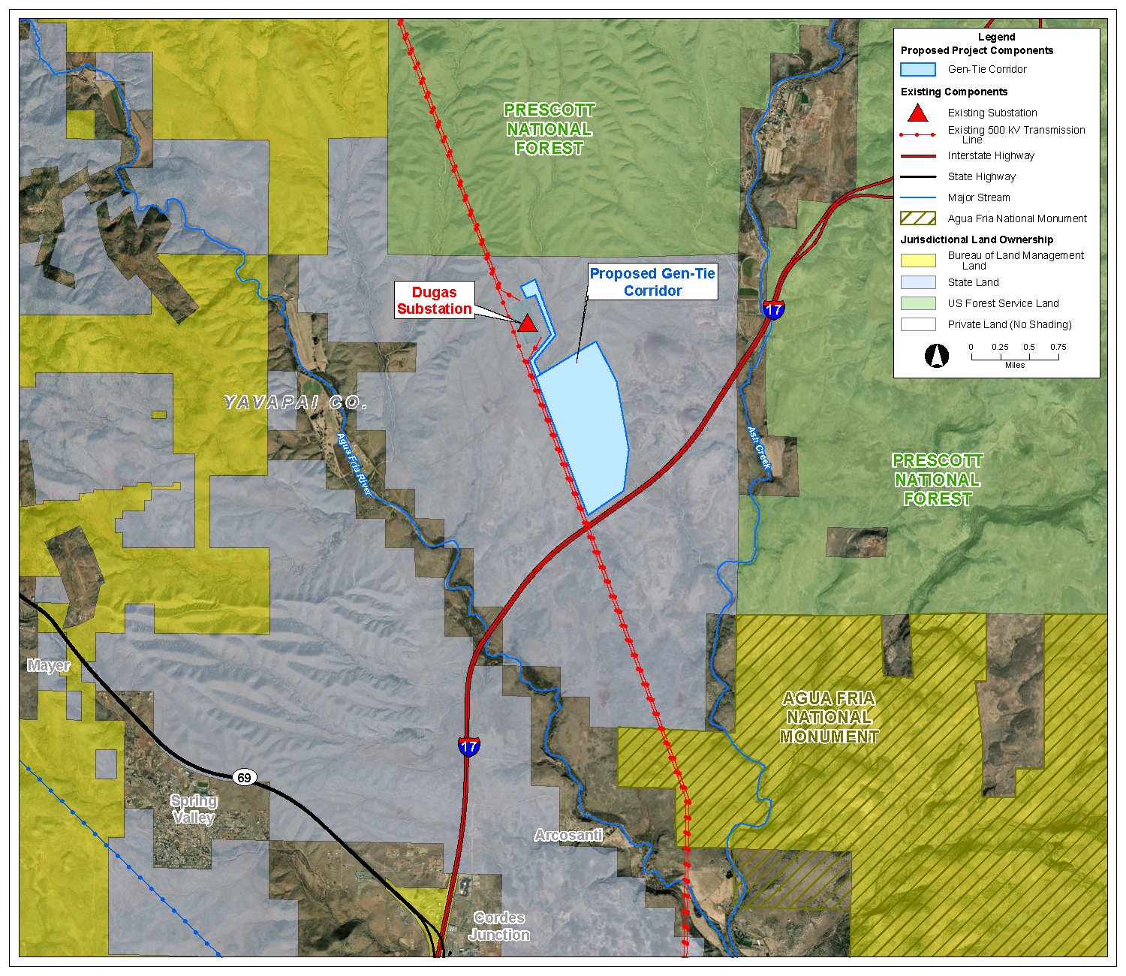

Slide 3
Alyssa Menzel
B.S. in Energy Engineering from Pennsylvania State University
Master’s Degree in Renewable Energy from University of Colorado
Manager of Development for Longroad Energy
8 years of experience including:
  Manufacturing Engineering and Commodity/Supply Chain Leader for GE Power, GE Renewable Energy, and GE Hydropower
  Researcher at the National Renewable Energy Laboratory
  Actively developing ~5 GW of solar + storage projects in Arizona
  Led permitting efforts for 1.3 GW of projects in Arizona

Slide 4
Ashley Groeneveld
B.A. in Geology from California Polytechnic University, Humboldt
Environmental Manager for Longroad Energy
11 years of experience including:
  Supporting developers in permitting and environmental compliance
  Leading environmental due diligence and wildlife conservation strategies
  Environmental consulting specializing in environmental investigation and remediation

Slide 5
Introduction

Slide 6
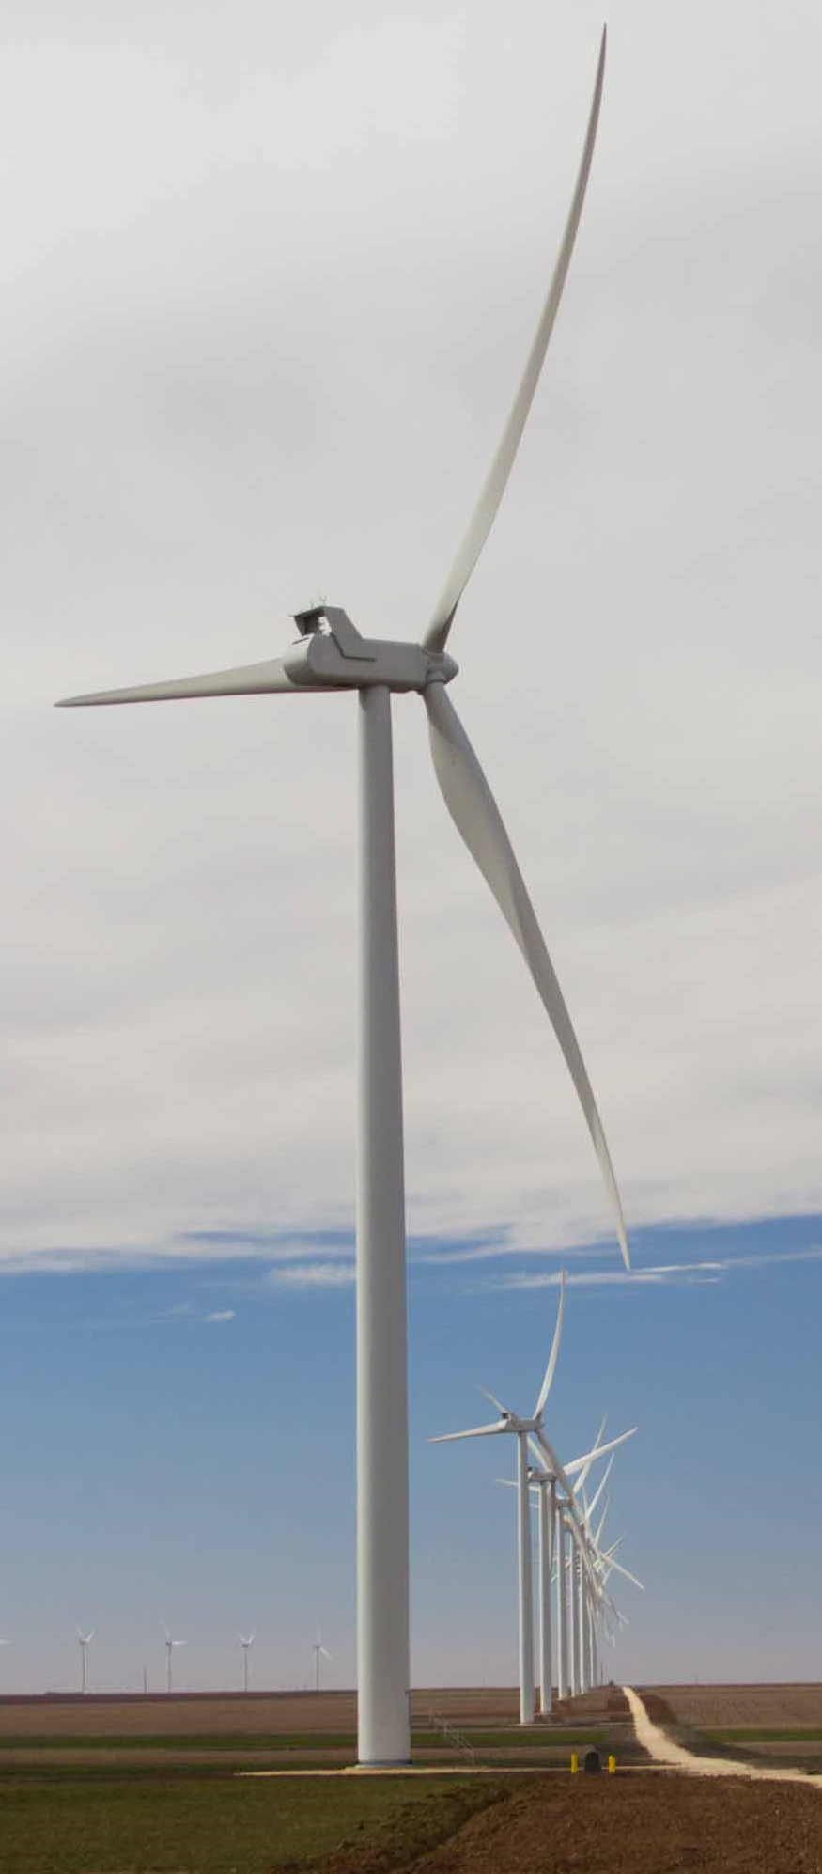



LONGROAD ENERGY
OUR IMPACT
5.6
GW DEVELOPED & ACQUIRED
3.7
GW OWNED
5.7
GW UNDER SERVICES CONTRACT
$15.3 B
Third Party Capital Raised
EXPERTISE
SUPPORT
OPERATIONS
Core team has worked together for more than 15 years We have developed 20+ renewable energy projects totaling 5.1 GW across the U.S. We have signed over 4 GW of corporate and utility PPAs within the last five years. Our motto is simple: make and honor well thought out commitments | Backed by experienced and committed investors with long-term goals We have the knowhow to bring all projects to completion and ensure long-term operation Long history of raising third-party capital, we have raised over $20 billion during our time together from more than 20 institutions | We built a world class operations and asset management Remote Operations Center (ROC) in Portland, Maine. We work with more than 100 different customers across the U.S. We manage the entire scope: Our ROC works around the clock, backed by experienced asset management, on-site technical support, and full back-office support. Longroad owns a portfolio of operating wind and solar assets, and we bring an owner’s mindset to the management of all projects, including those owned by third-parties
We are developers, owners and operators of renewable energy with a proven track record

Slide 7
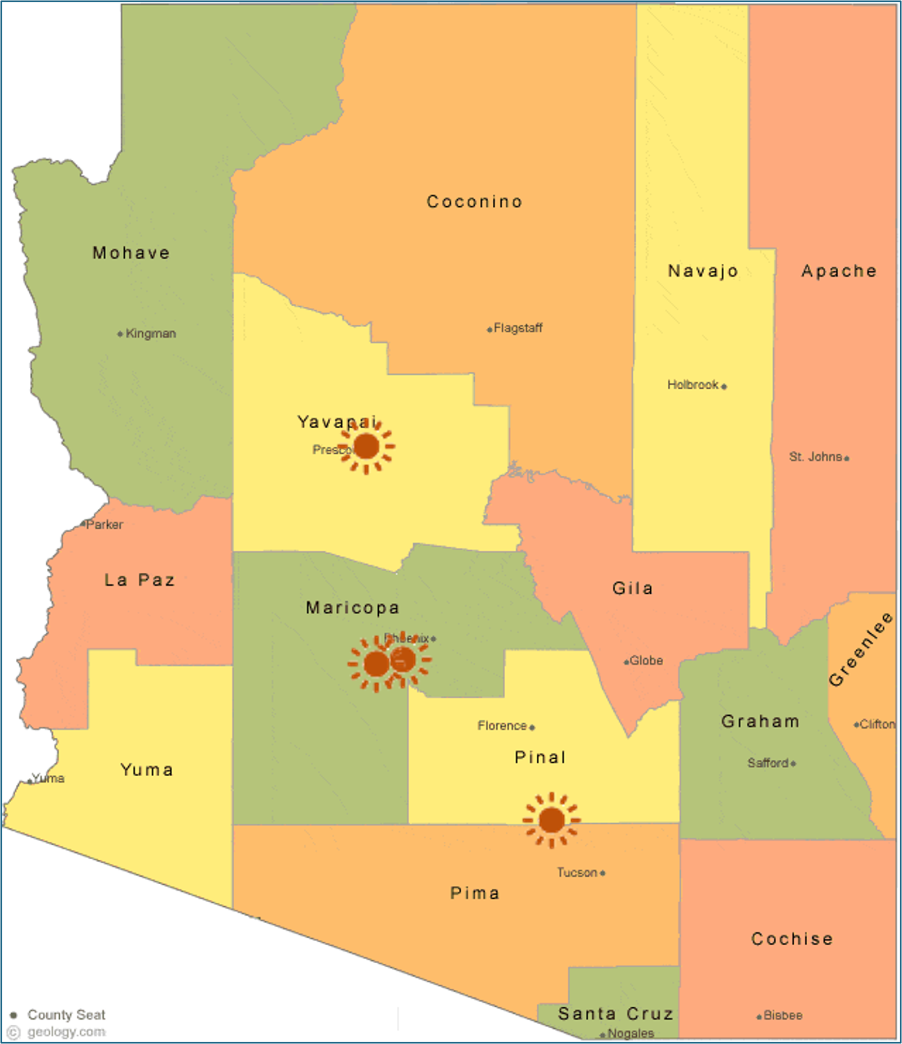
LONGROAD ARIZONA ASSETS

Slide 8




WILDLIFE CONSERVATION STRATEGY
INCLUDES ASSESSMENT OF WILDLIFE AND WILDLIFE HABITAT IN PROJECT AREA
  Threatened & Endangered Species Habitat Assessment
  Reconnaissance and Protocol Level Surveys
  Vegetation Management Plan
  BMPs designed for avoidance and minimization
BEST MANAGEMENT PRACTICES
  Identifies area for avoidance (wetlands and critical habitat)
  Includes wildlife corridors through Project arrays
  Wildlife-friendly management techniques

Slide 9
Project Description

Slide 10
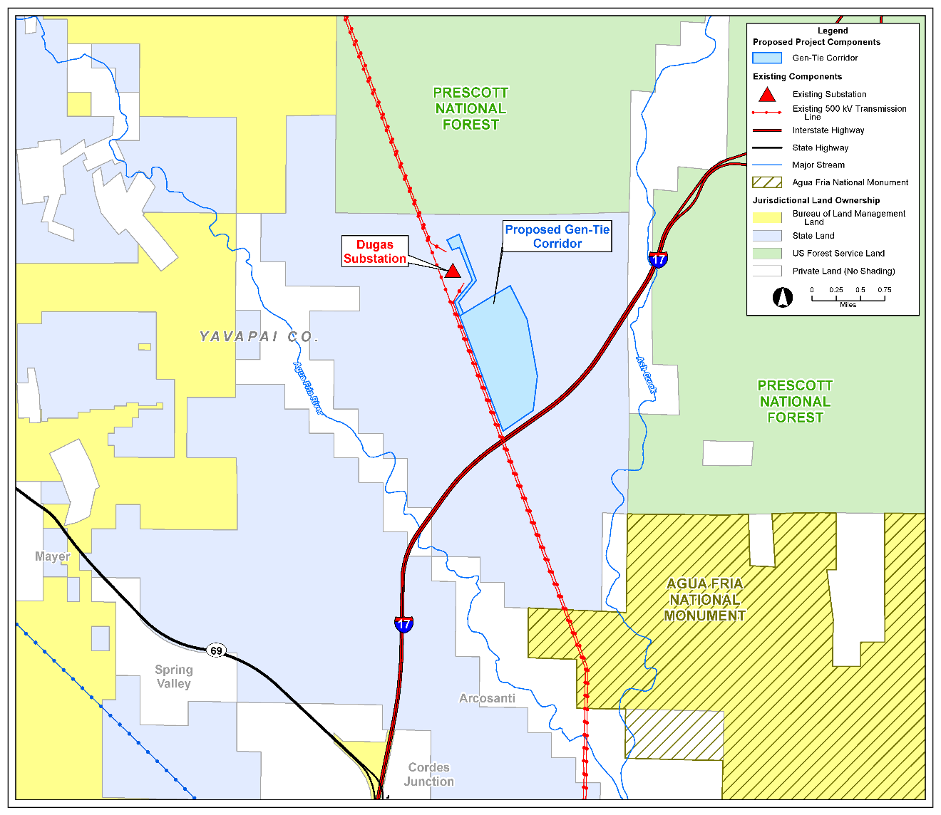
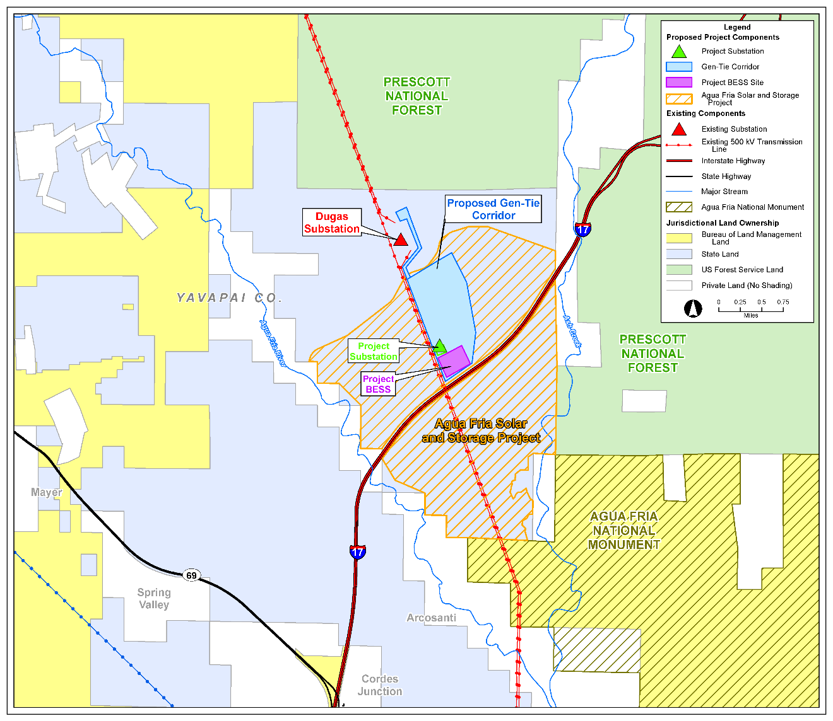

Slide 13
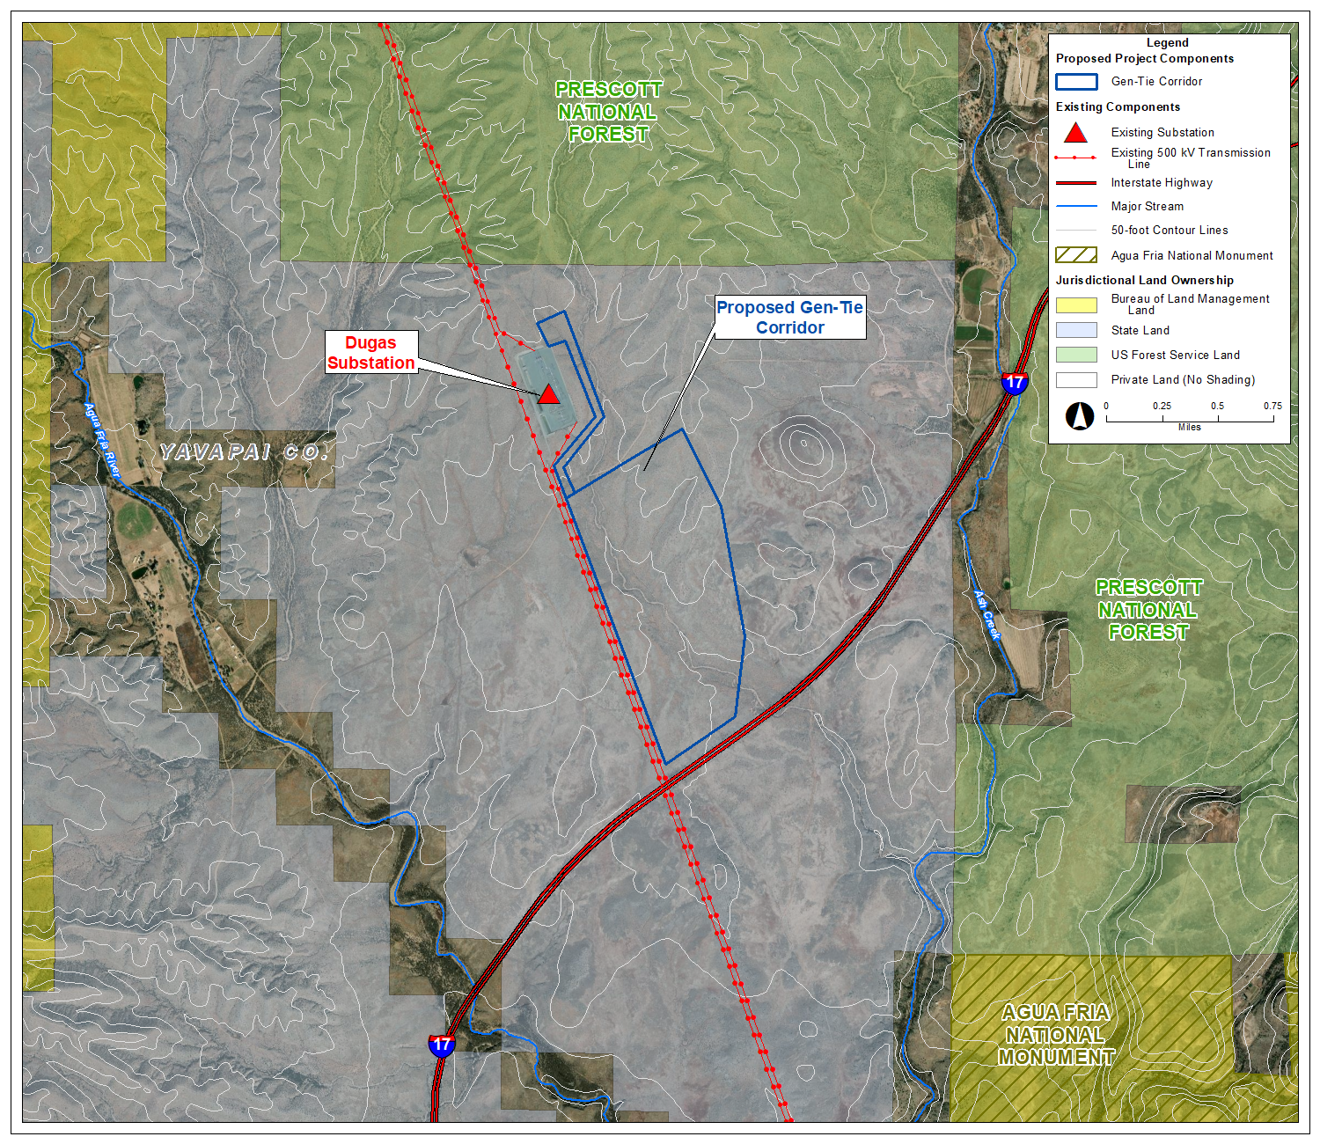

Slide 14
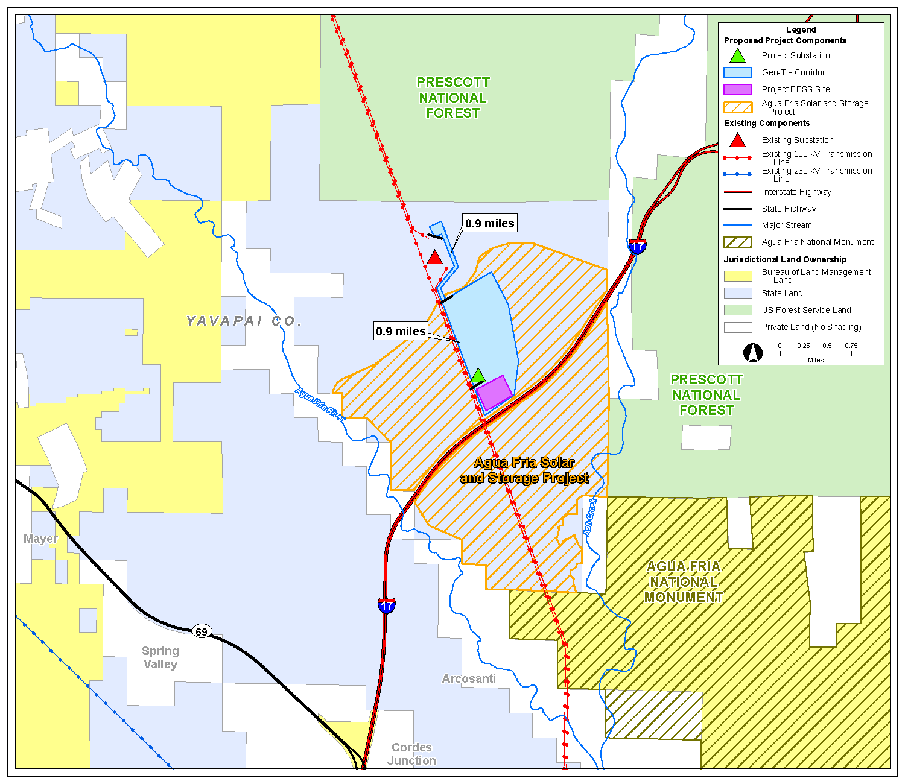

Slide 15
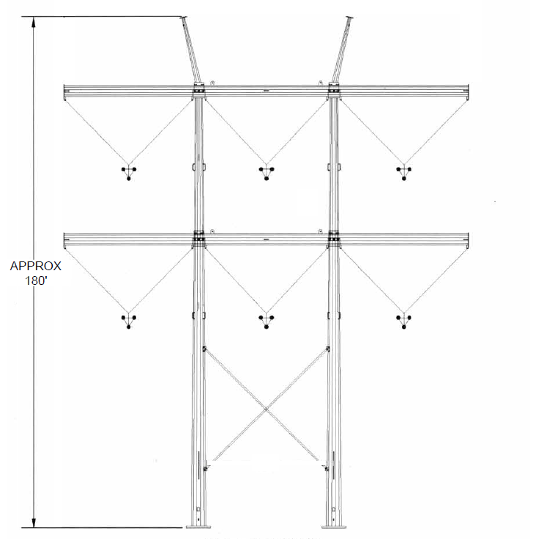
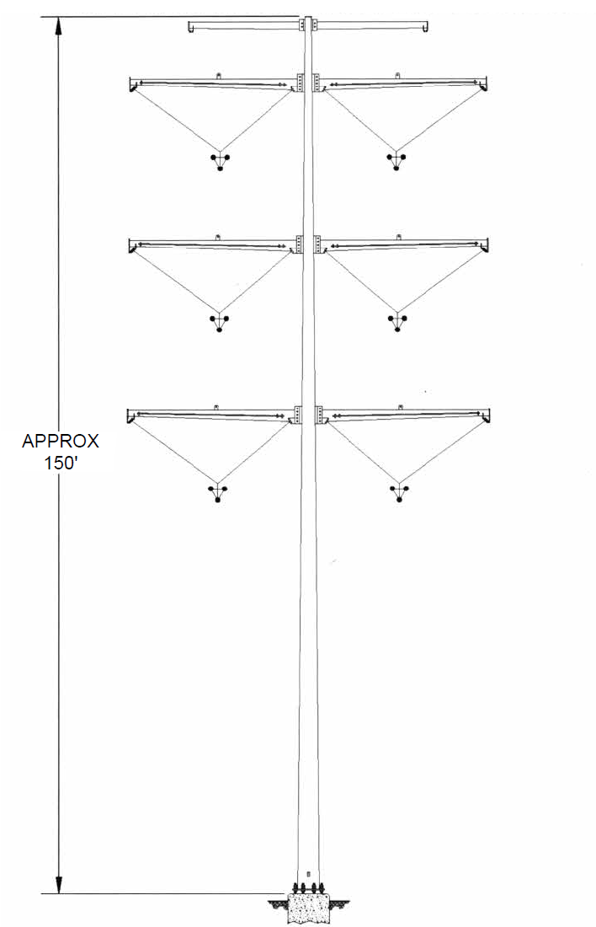
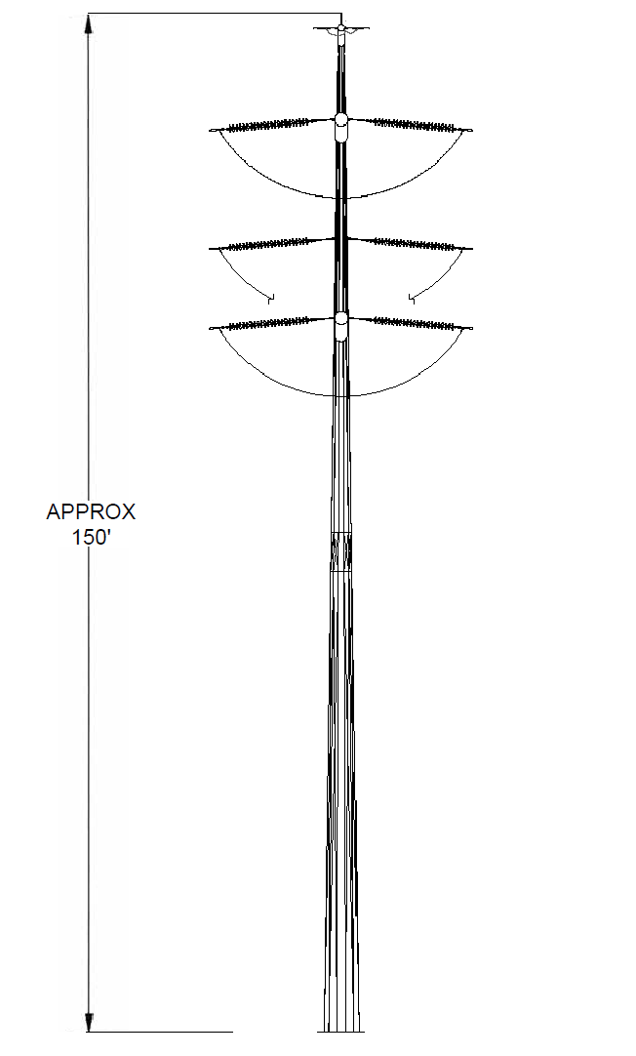
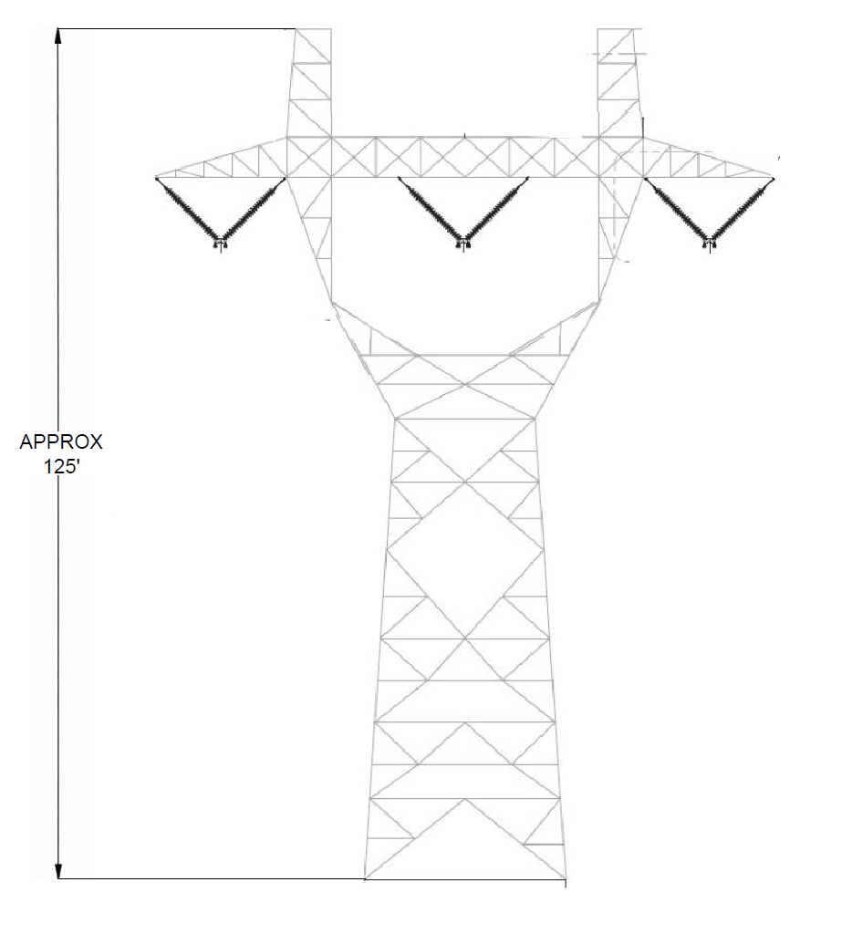
STRUCTURE TYPES
Typical right-of-way width 250 feet
Represents typical structures. Actual structure types for this project have not yet been determined and may vary depending on location.​

Slide 16
Project Need and Benefits

Slide 18
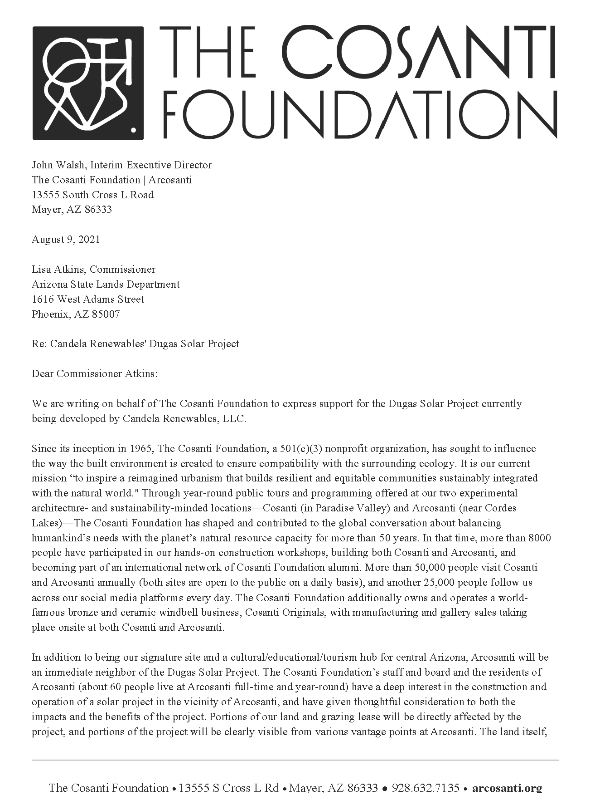
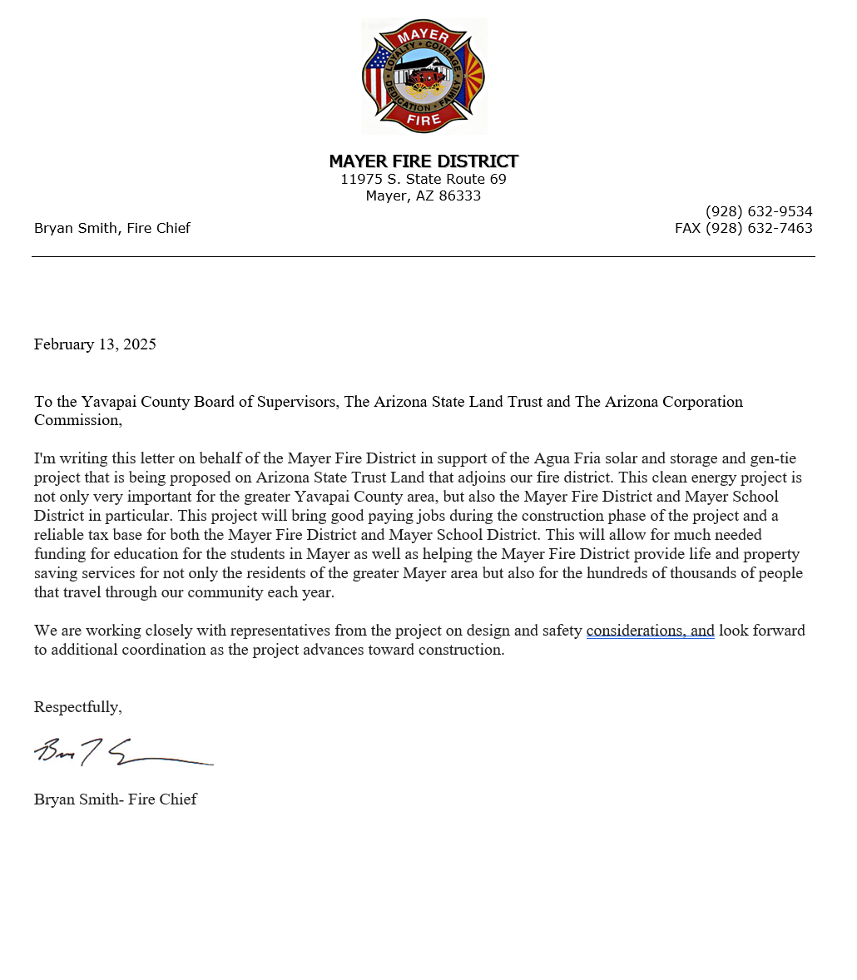
LETTERS OF SUPPORT

Slide 19
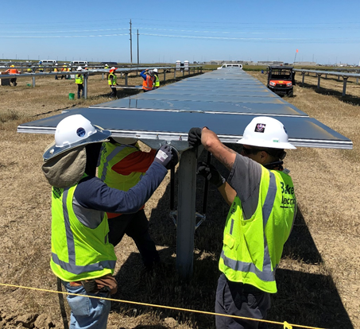

Slide 20
Steve Morgan
B.S. in Environmental Conservation and Sustainability from the University of New Hampshire
M.S. in Environmental Science and Policy from Johns Hopkins University
10 years of environmental consulting experience
  Specialize in environmental planning for energy projects, regulatory permitting, and construction compliance
  Experience on over 100 transmission and generation projects across the southwest
  Previously testified before the Committee on Cases No. 205 and 233

Slide 21
Environmental Analysis
Overview and Results of Studies

Slide 22
OVERVIEW OF ENVIRONMENTAL STUDIES
Ownership, Jurisdiction and Land Use (Exhibits A and B)
Biological Resources (Exhibits C and D)
Visual Resources (Exhibit E)
Cultural Resources (Exhibit E)
Recreation Resources (Exhibit F)
Existing Plans (Exhibit H)
Noise (Exhibit I)

Slide 23
Land Use
Ownership, Jurisdiction and Land Use

Slide 24
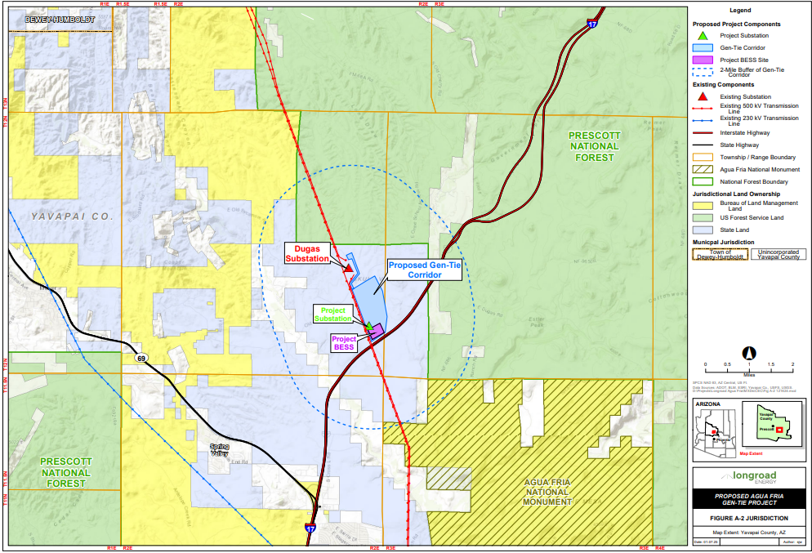

Slide 25
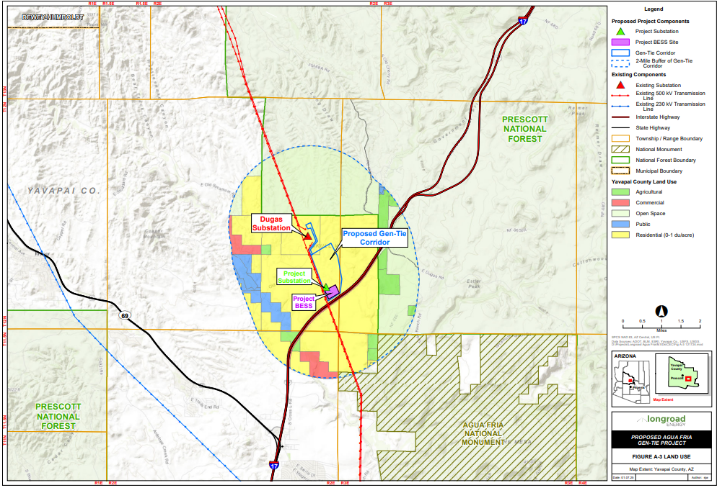

Slide 26
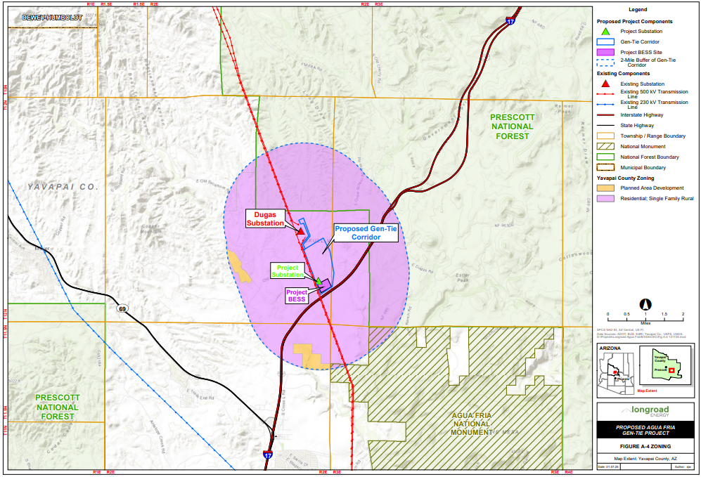

Slide 28
Biological Resources
Analysis of Biological Wealth and Biological Resources

Slide 29
BIOLOGICAL RESOURCES SUMMARY
Coordinated with AGFD and USFWS
  USFWS IPaC Tool
  AGFD ERT Report
No designated or critical habitat
Sensitive Species unlikely to be affected
Environmentally Protective BMPs

Slide 30
Visual Resources
Visual Impacts and Simulations

Slide 31
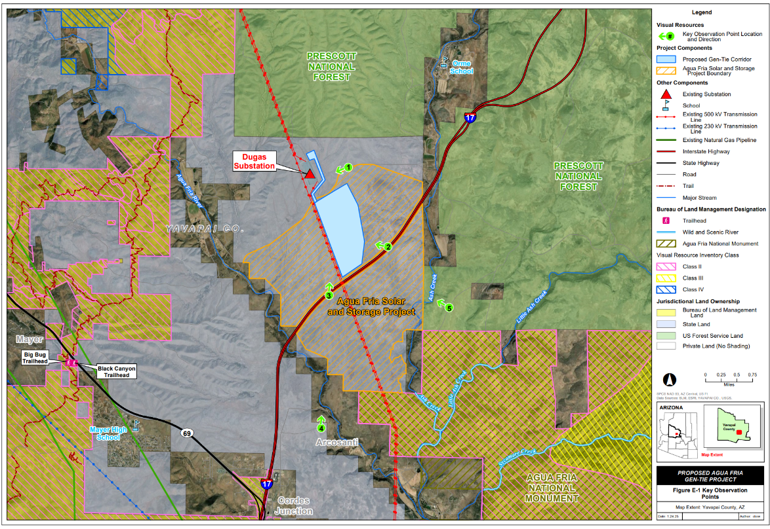

Slide 32
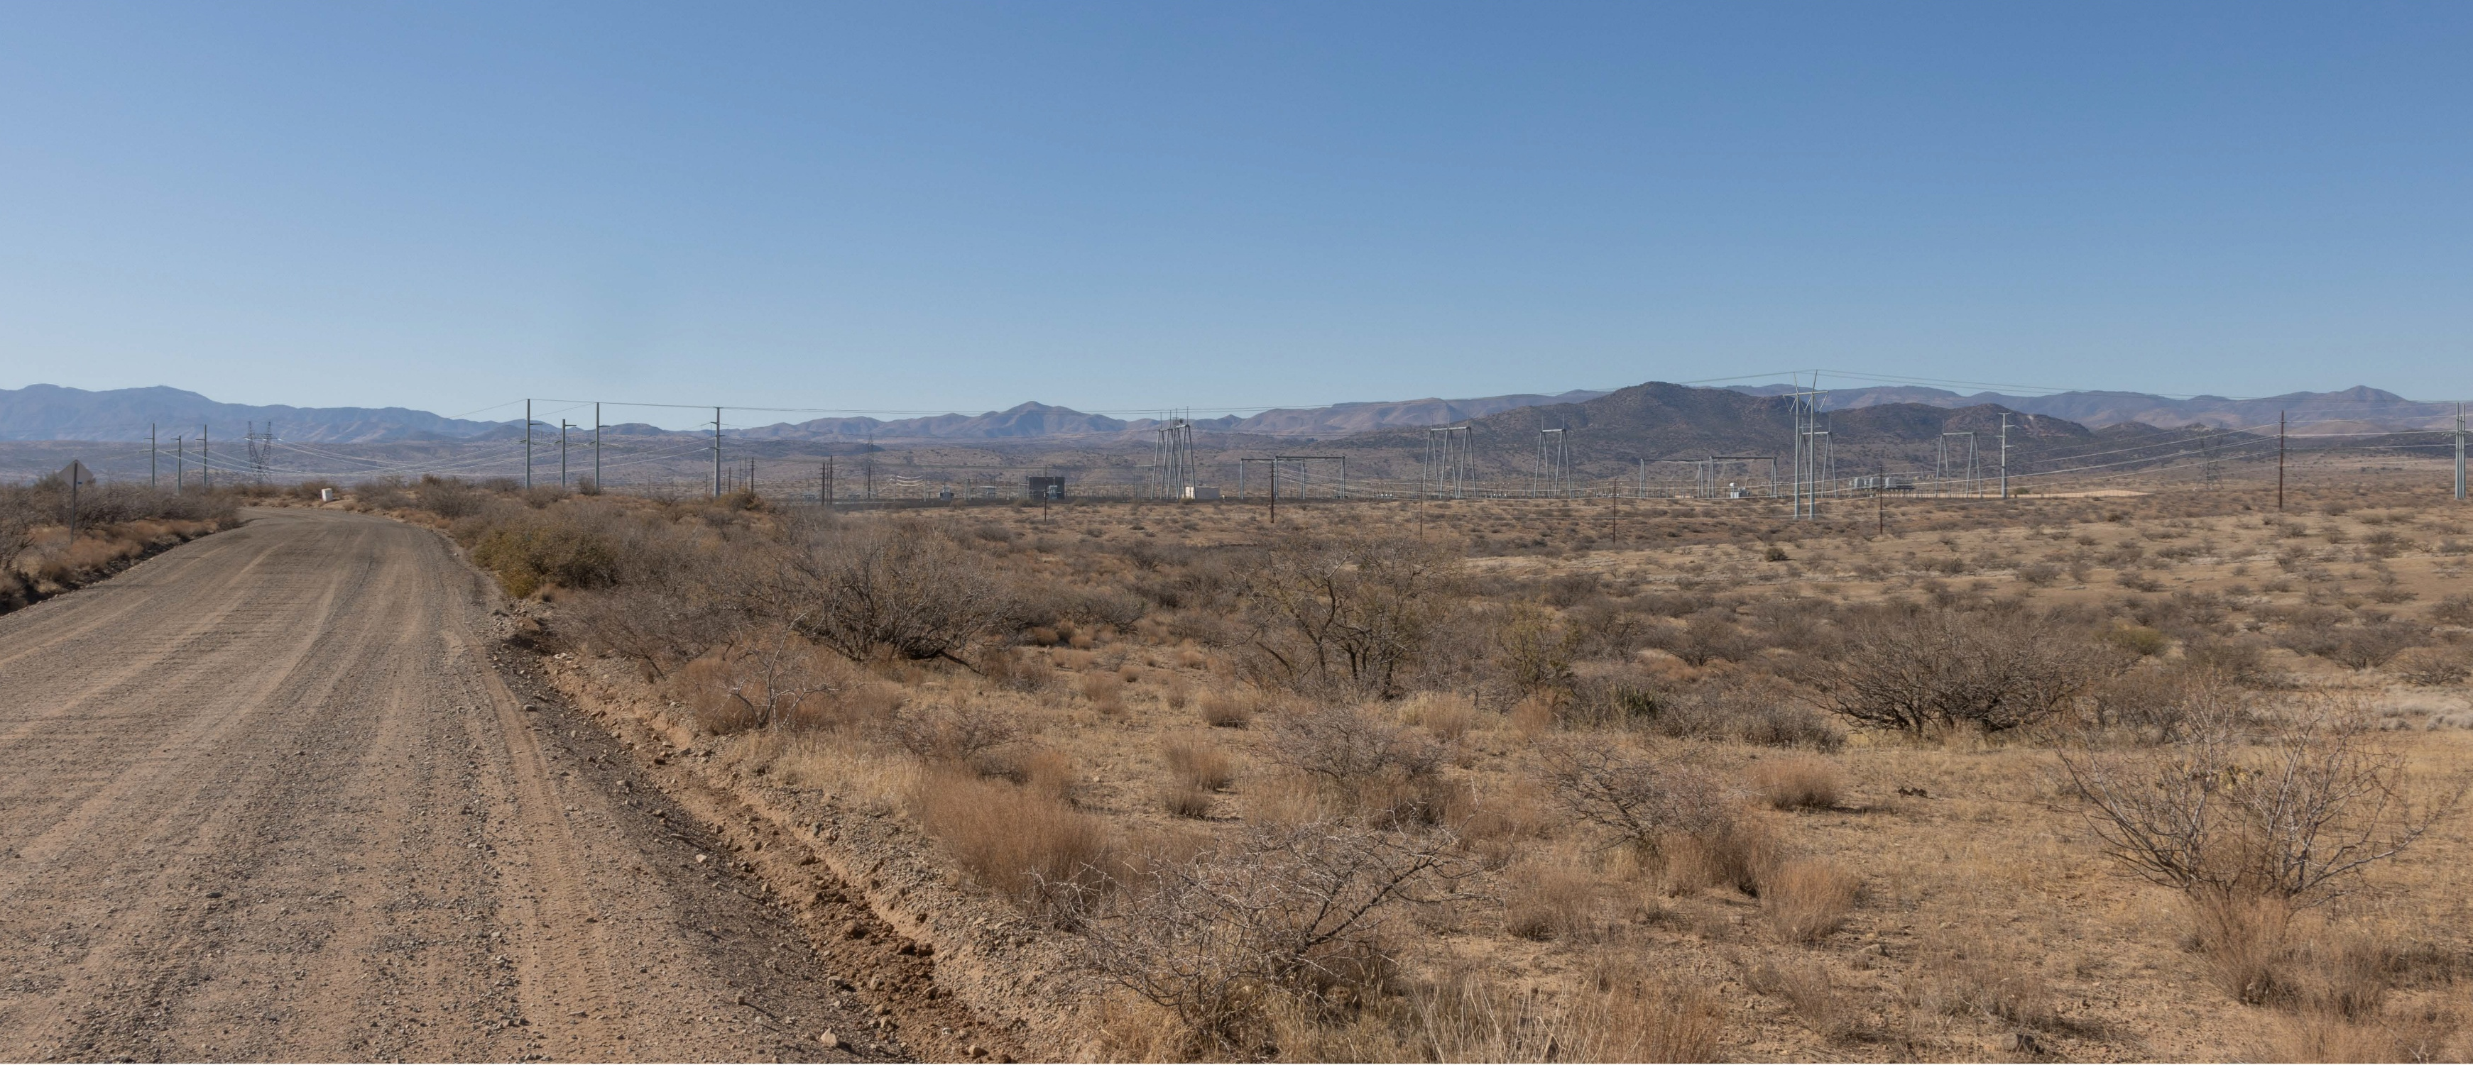
KOP 1 – Proposed View
Old Sycamore Road
Looking West
Figure E-2

Slide 34
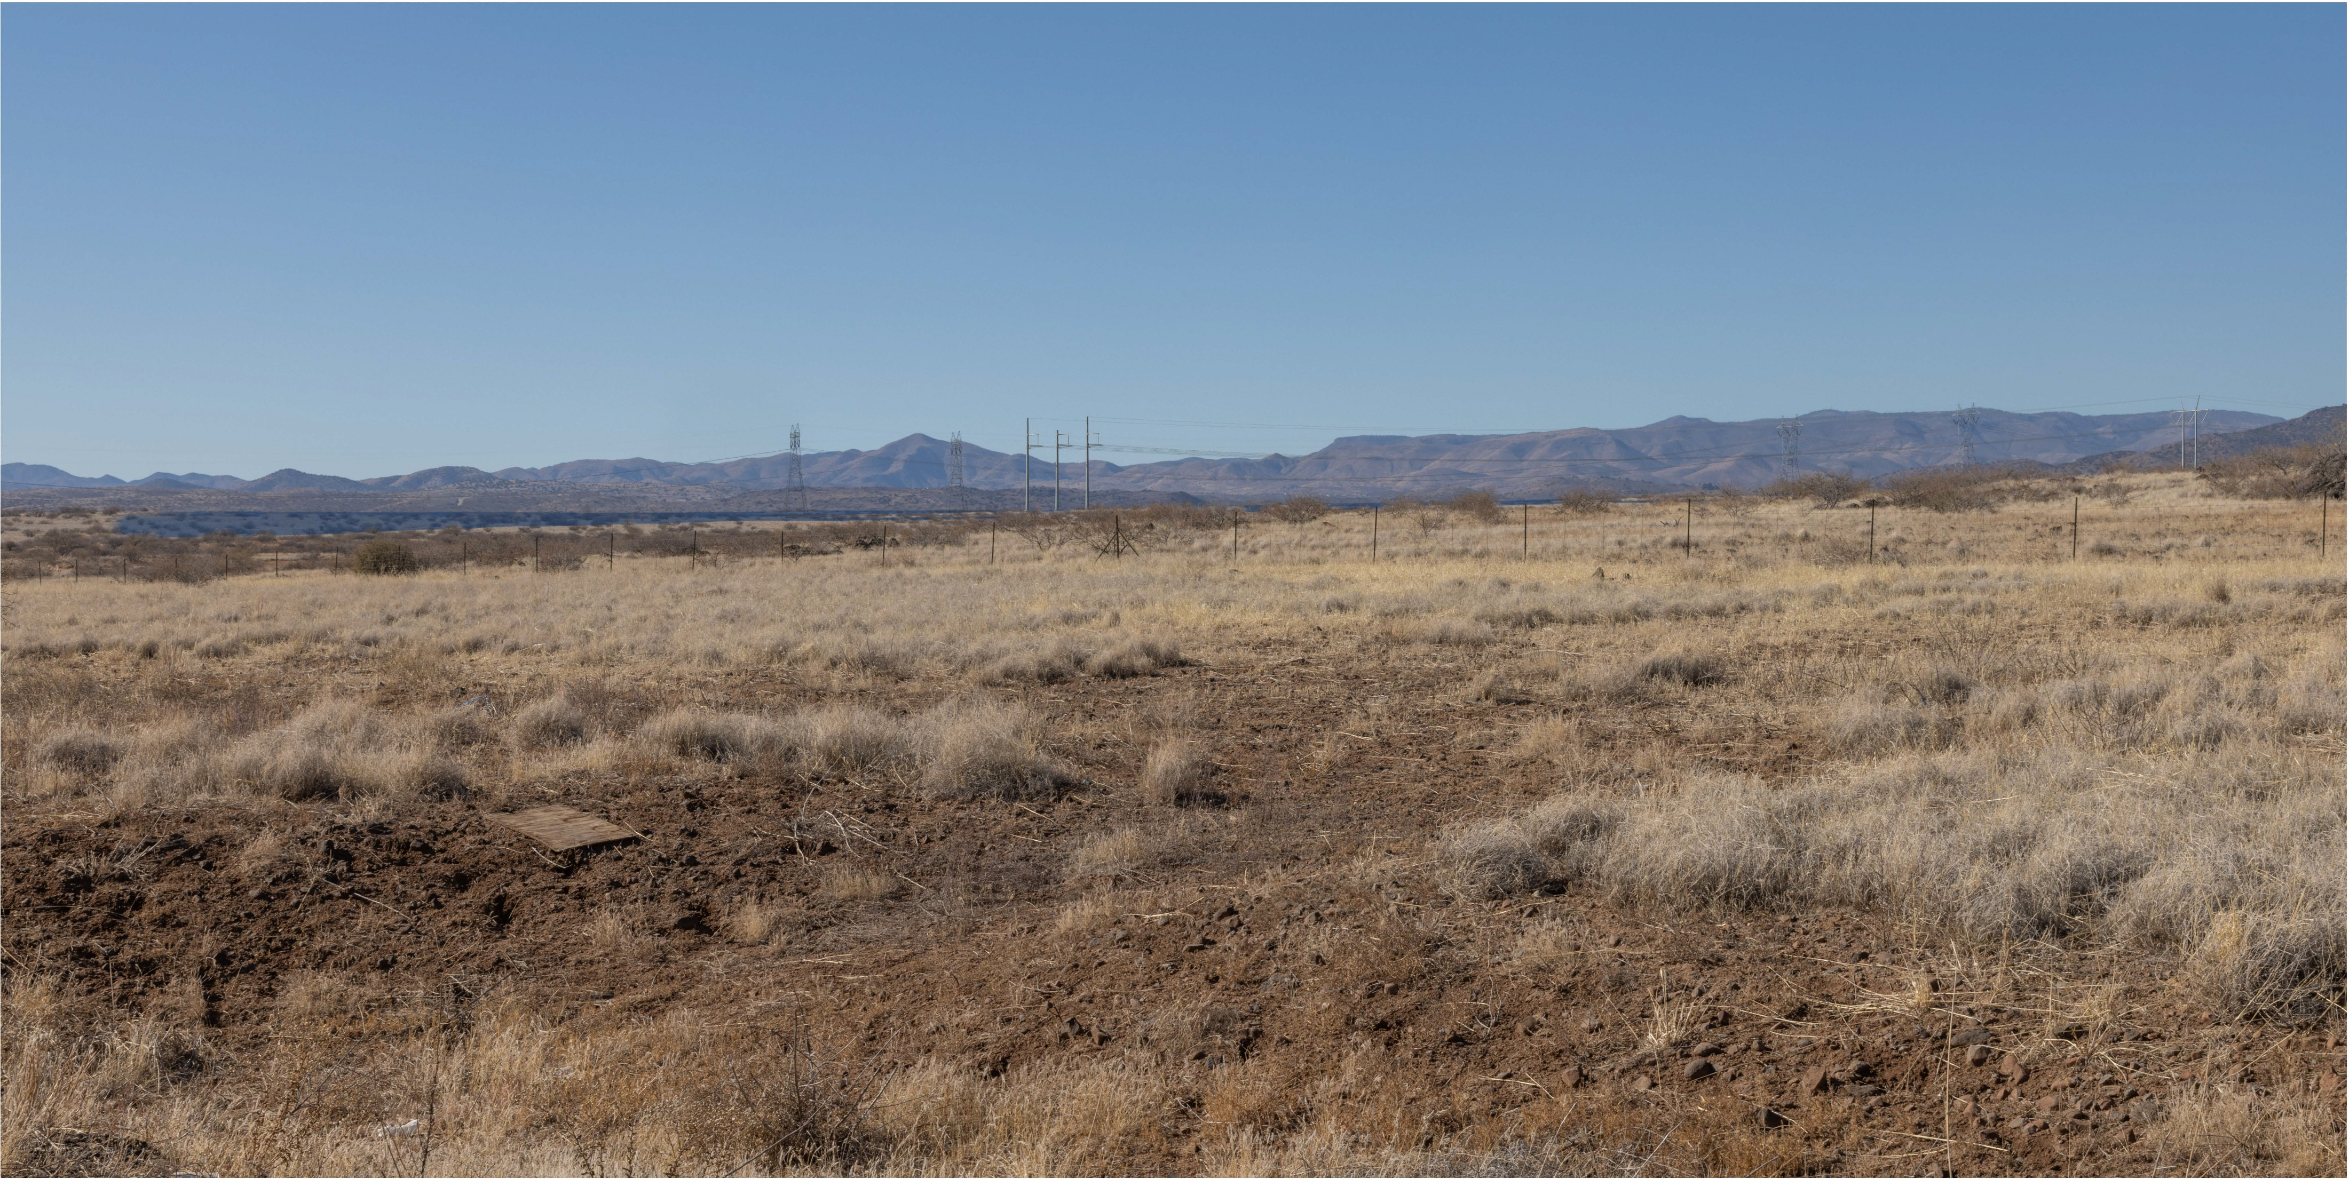
KOP 2 – Proposed View
Southbound I-17
Looking Northwest
Figure E-3

Slide 35
R38

Slide 36
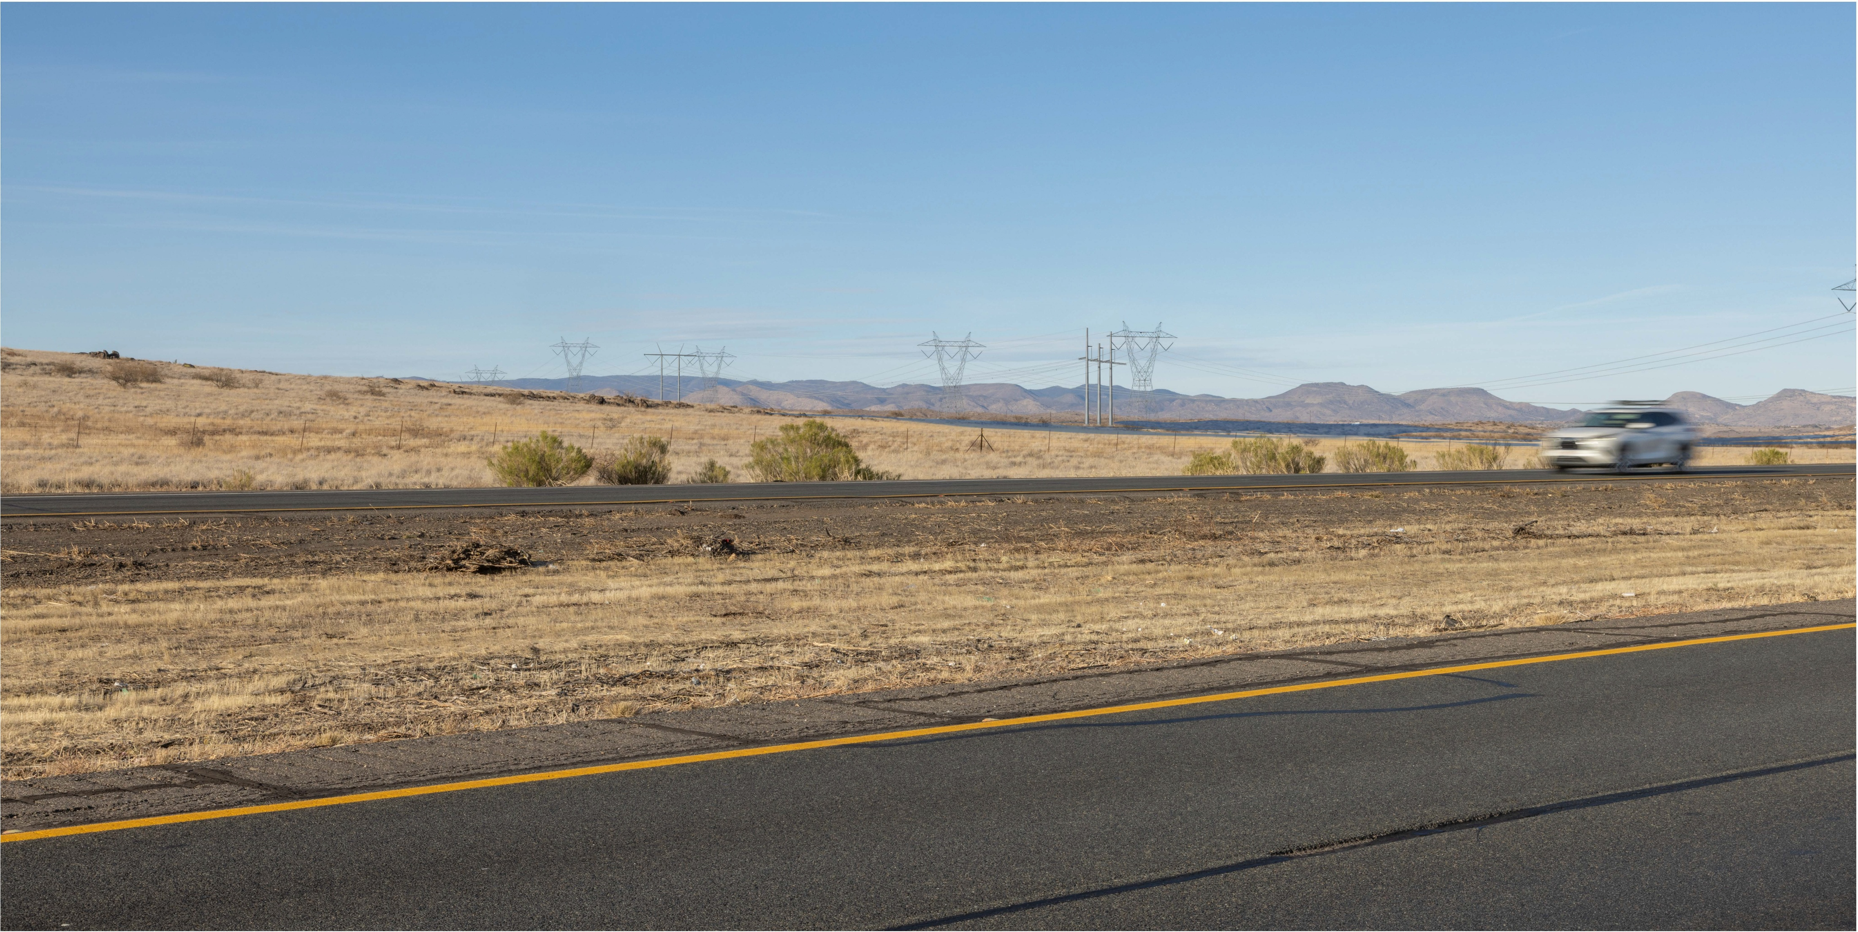
KOP 3 – Proposed View
Northbound I-17
Looking North
Figure E-4

Slide 38
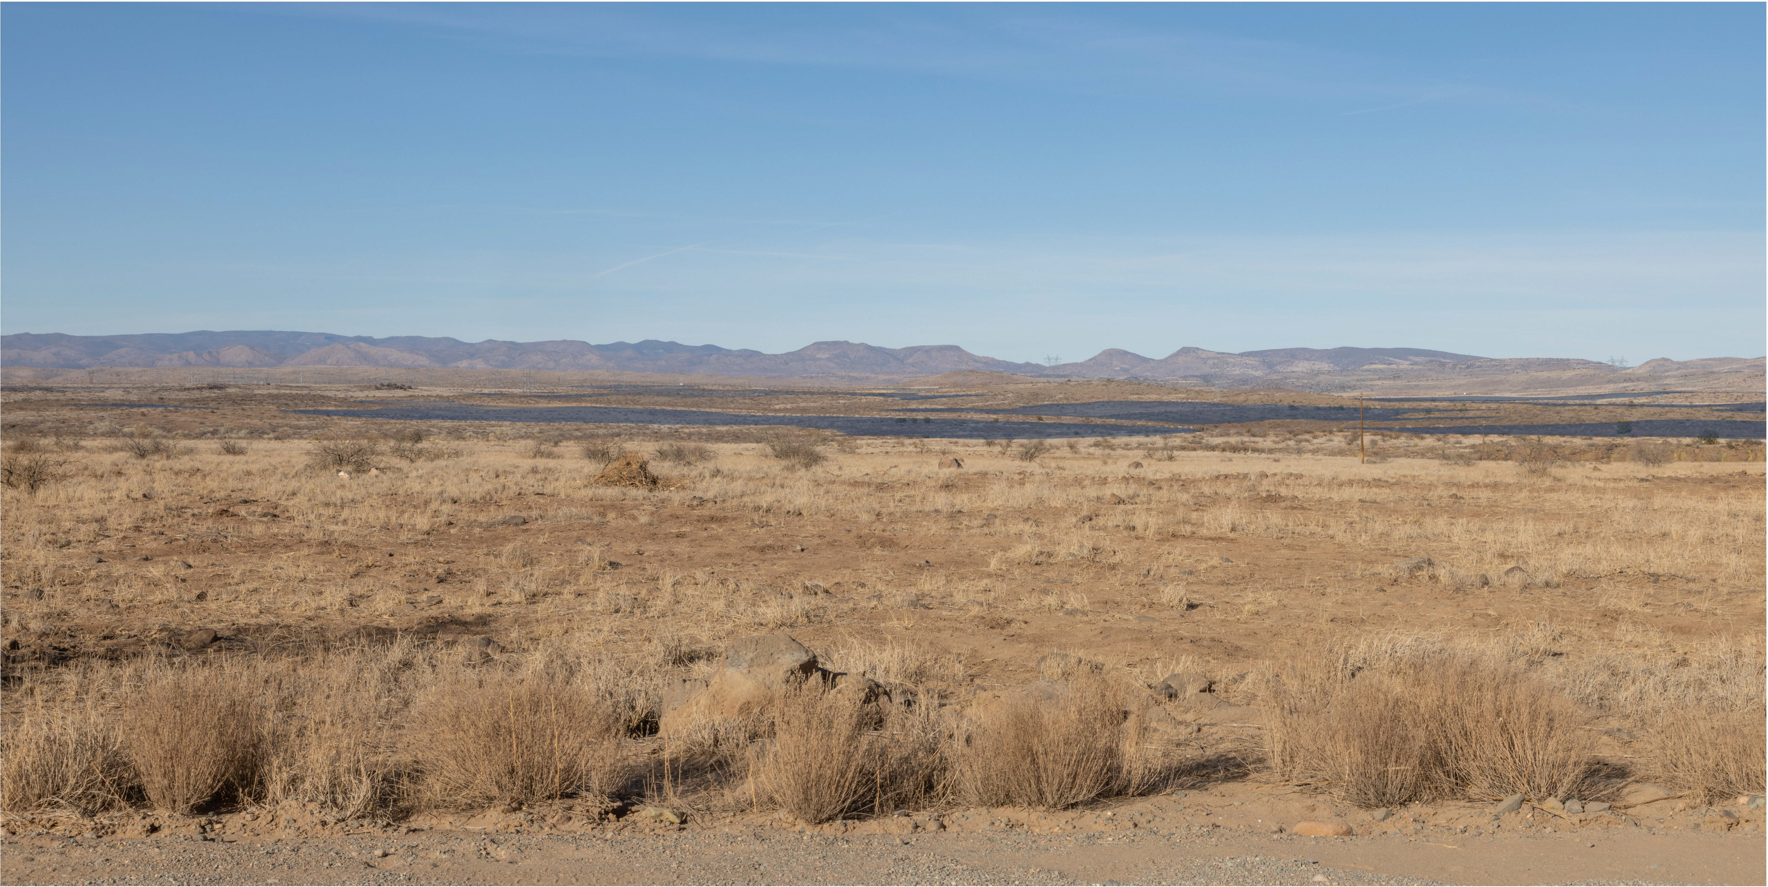
KOP 4 – Proposed View
Cross L Road
Looking North
Figure E-5

Slide 40
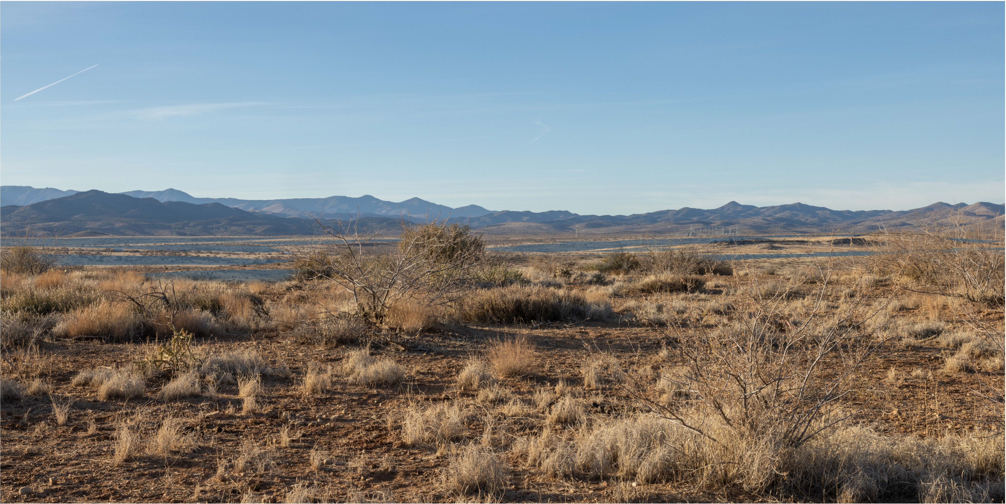
KOP 5 – Proposed View
Prescott National Forest
Looking Northwest
Figure E-6

Slide 41
Virtual Route Tour
What will the Project look like?

Slide 42
Cultural Resources
Historic and Archeological Sites

Slide 44
Recreational Areas
Existing and Future Recreational Sites

Slide 45
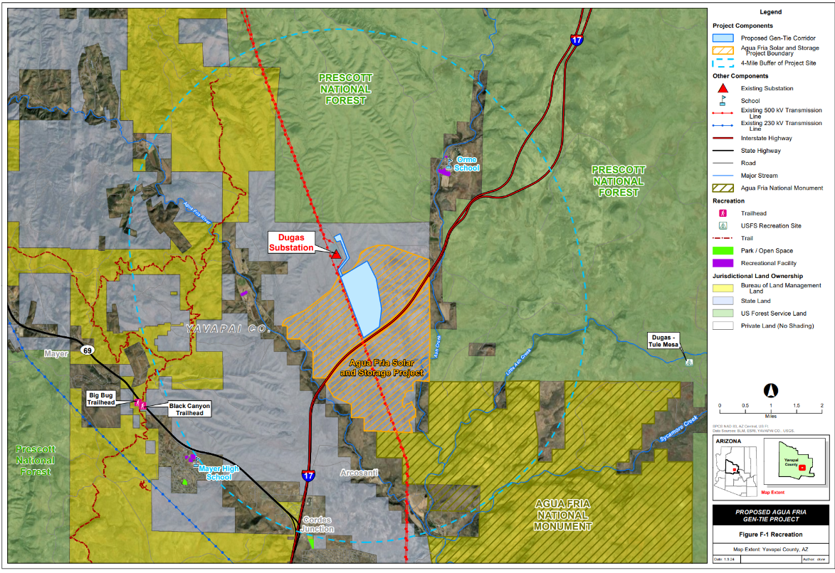

Slide 46
Existing Plans
Plans of State, Local Government and Private Entities

Slide 47
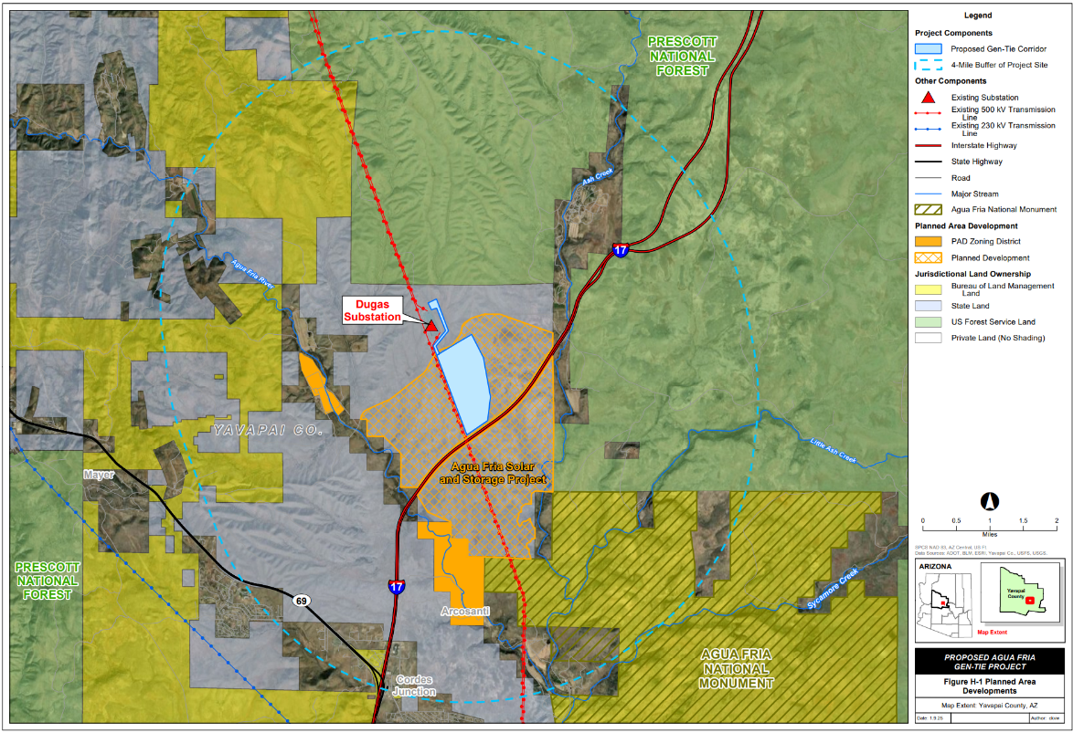

Slide 48
Noise and Communications
Anticipated Noise Levels and Potential Interference

Slide 50
Environmental Conclusions
Project is Environmentally Compatible

Slide 51
SUMMARY OF ENVIRONMENTAL COMPATIBILITY
No significant or detrimental effects to land use or jurisdictions
No significant or detrimental effects to fish, wildlife, plant life, and associated forms of life upon which they are dependent
No significant or detrimental effects to existing scenic areas, historic sites and structures, or archaeological sites at or in the vicinity of the Project
No plans for future development of recreational facilities associated with the Project or detrimental effects to area plans
No significant or detrimental effects associated with noise emission levels and interference with communication signals
The Project is environmentally compatible with the total environment of the area

Slide 52
Statutory Notice
Publication, Posting, Affected Jurisdictions

Slide 53
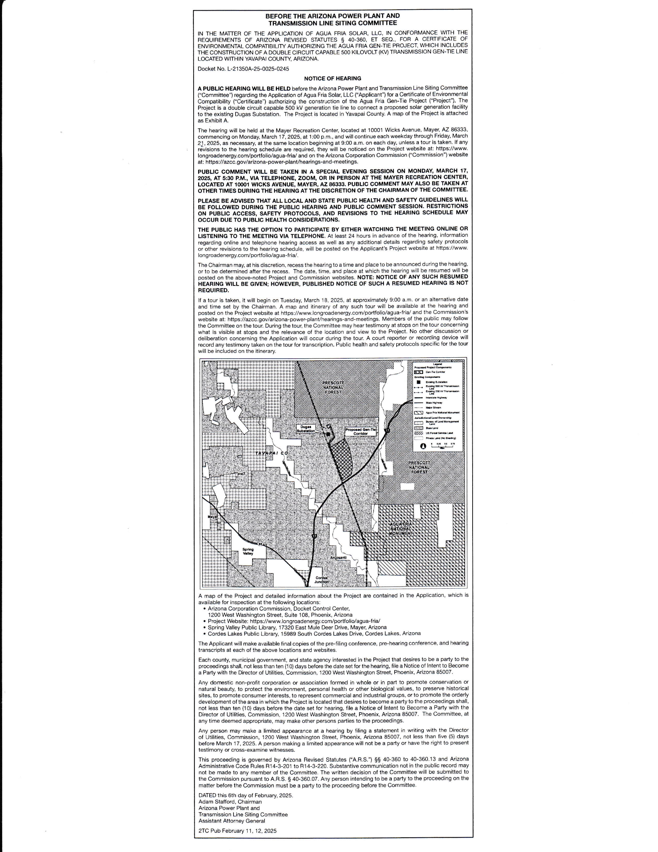
NEWSPAPER PUBLICATIONS

Slide 54
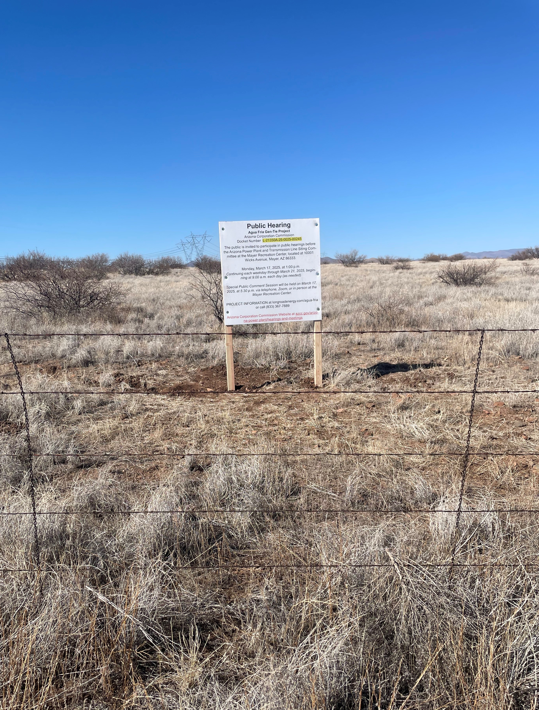
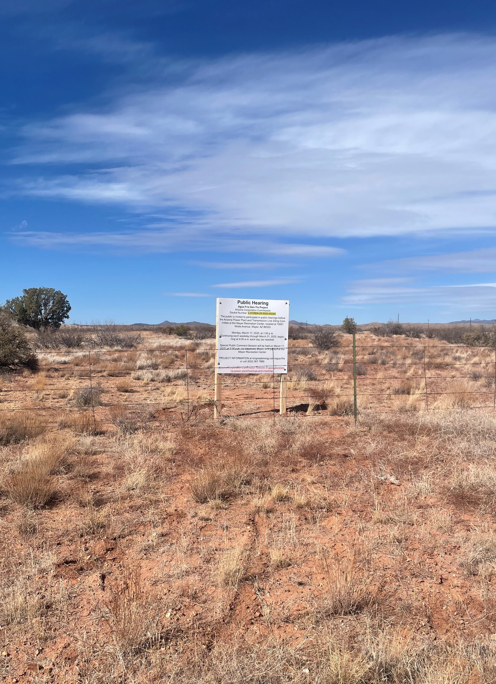
PROJECT SIGNS

Slide 55
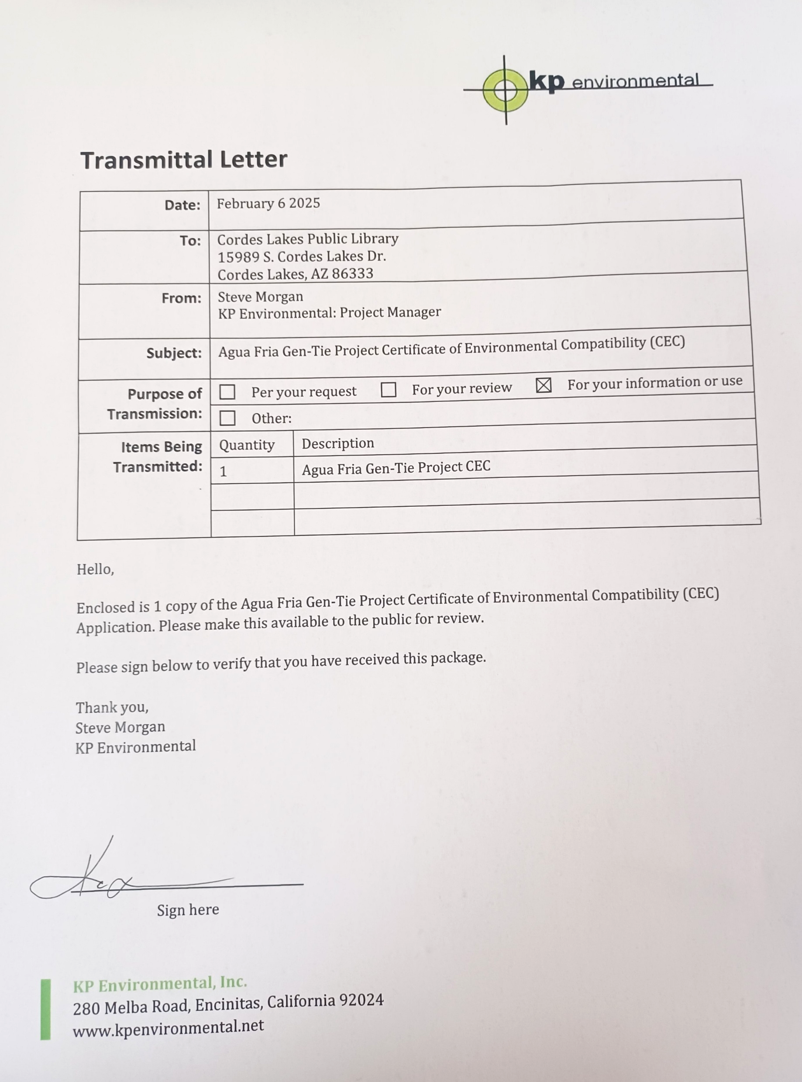
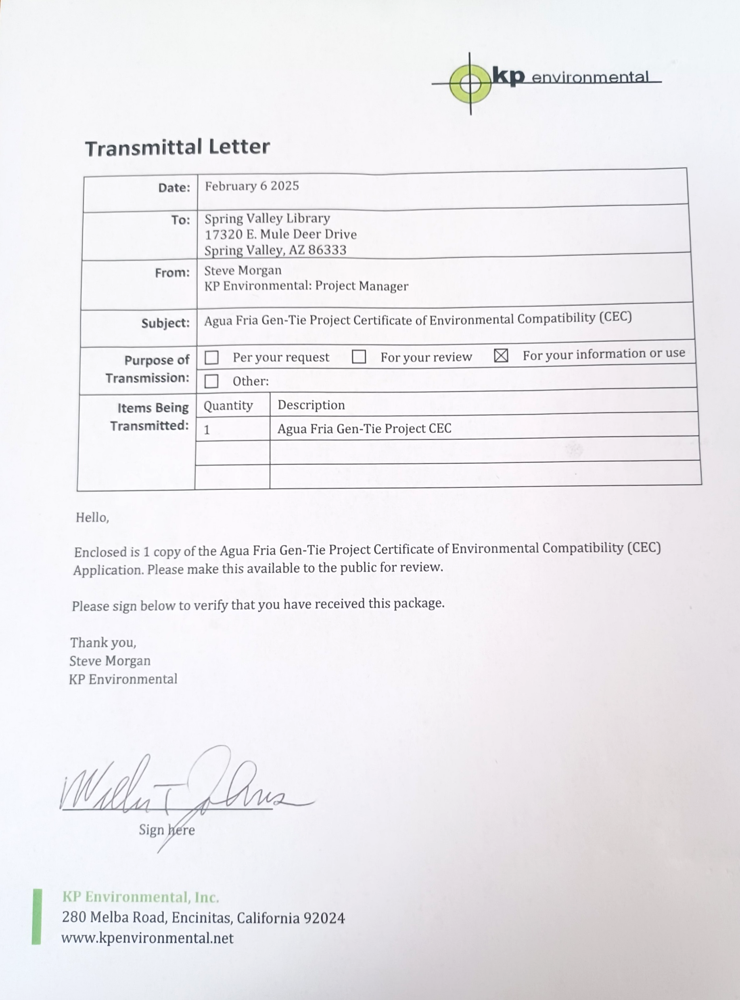
NOTICE OF FILING

Slide 56
Public Process
Public and Stakeholder Involvement

Slide 57
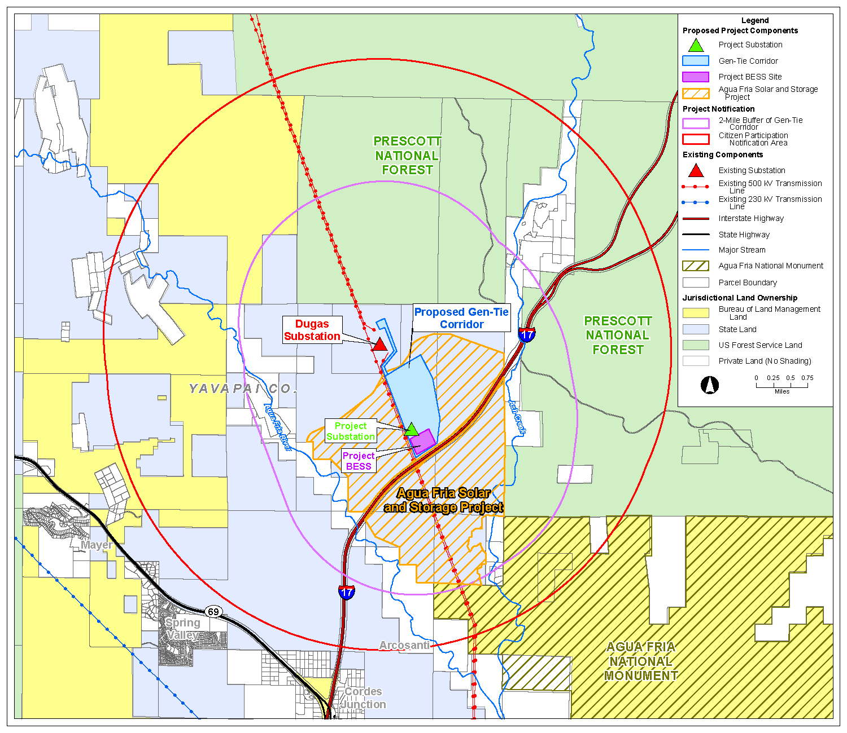
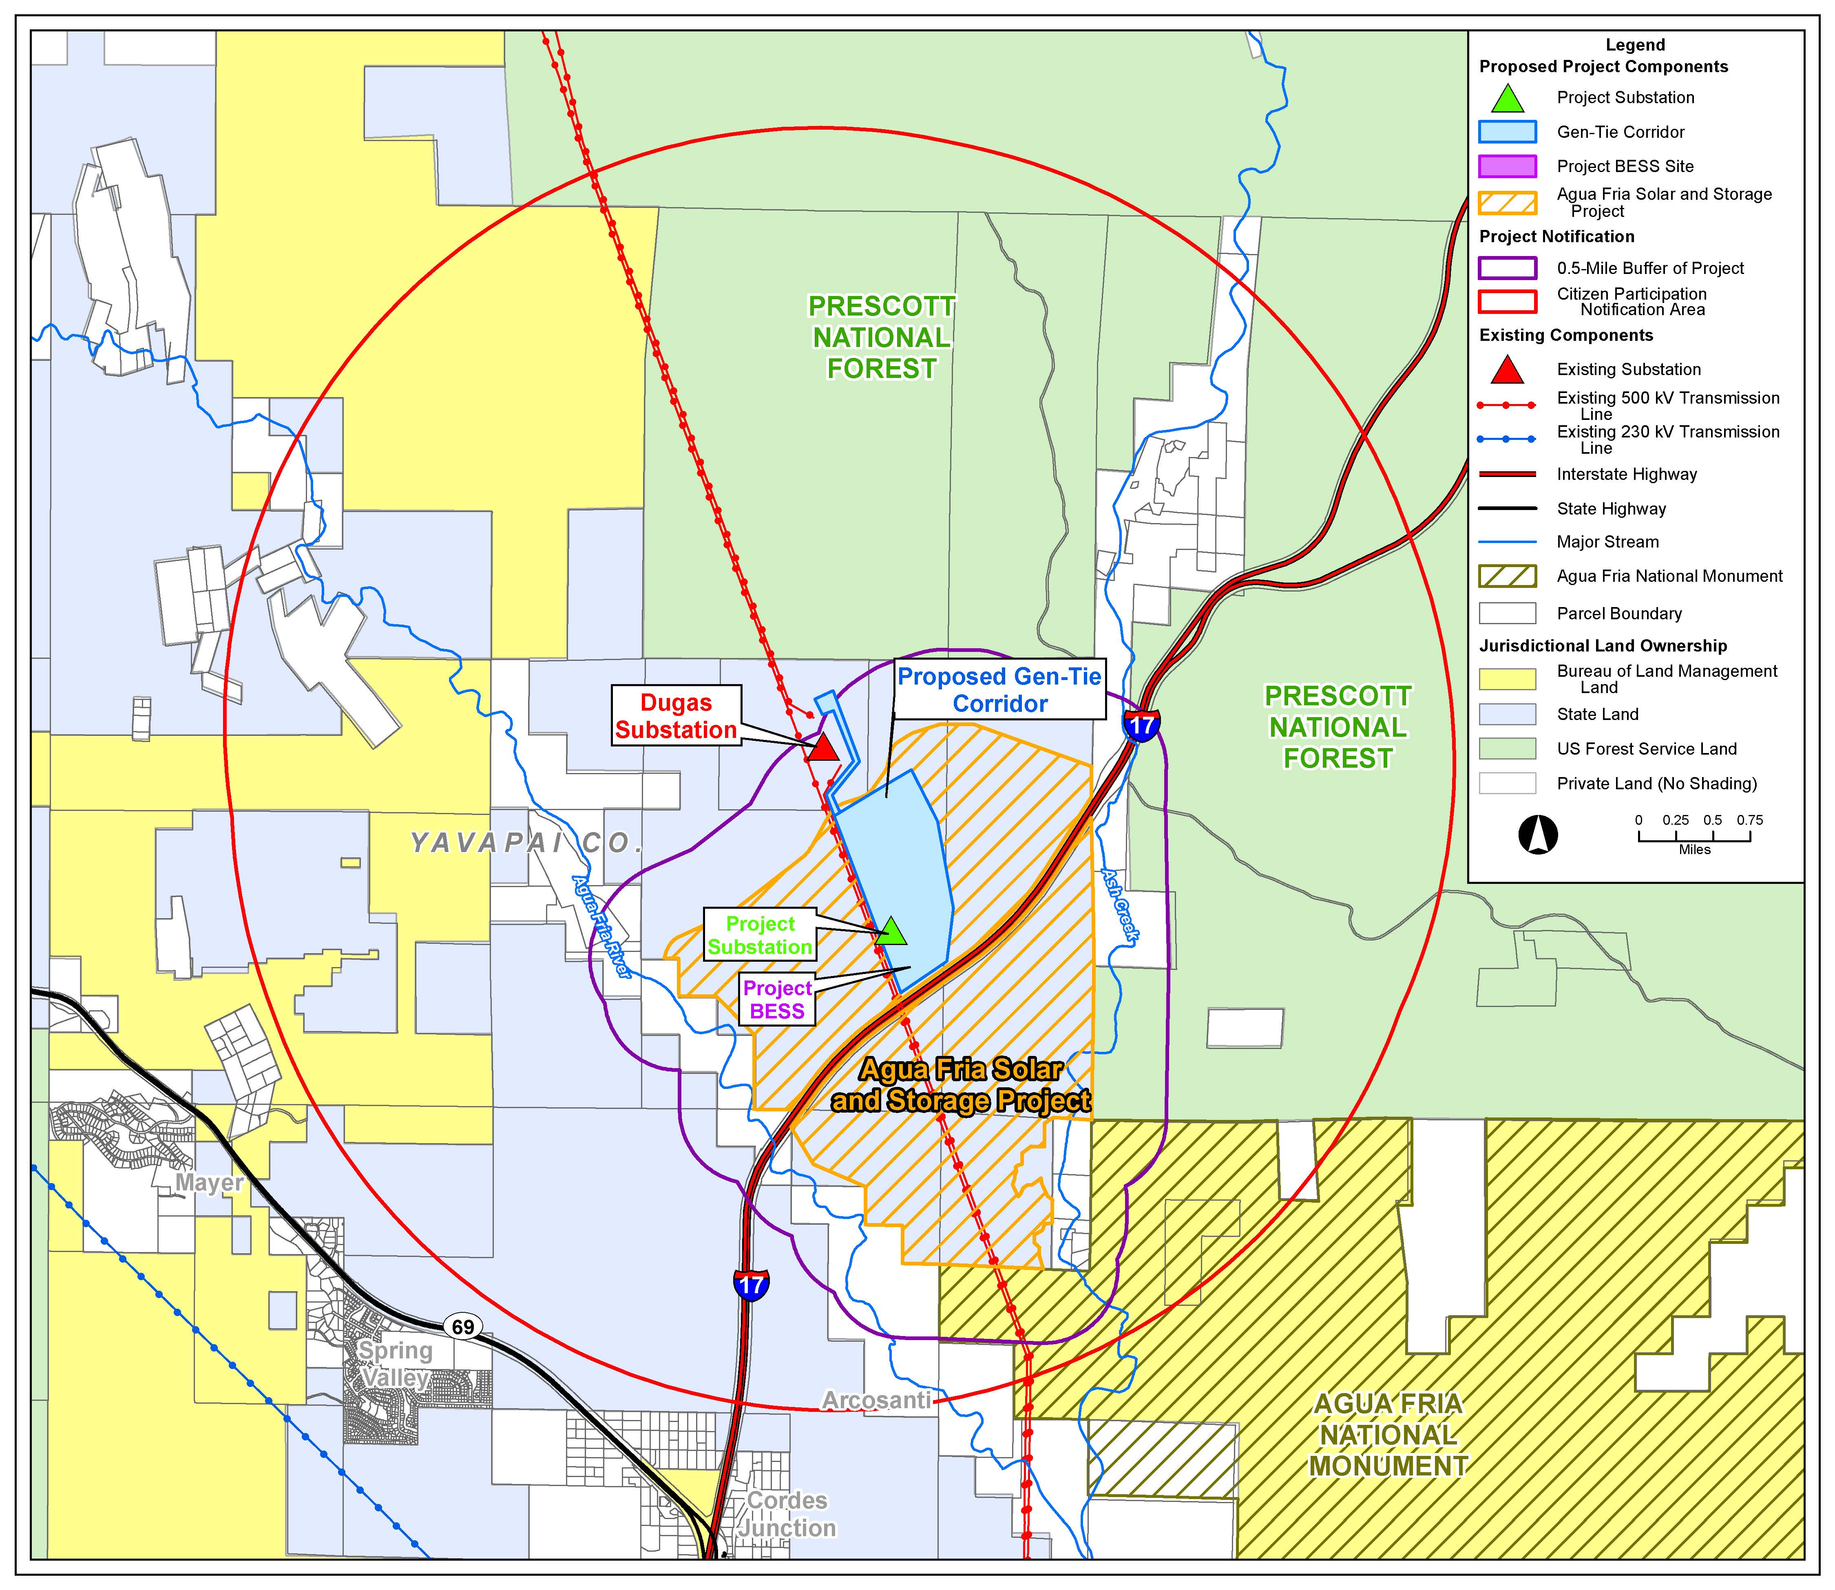

Slide 58
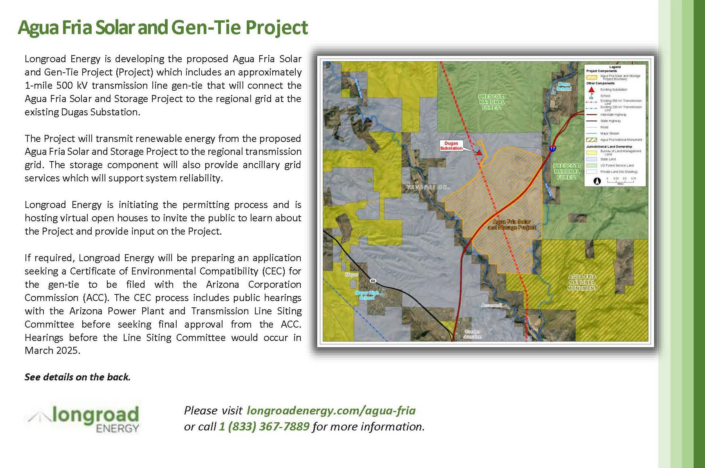
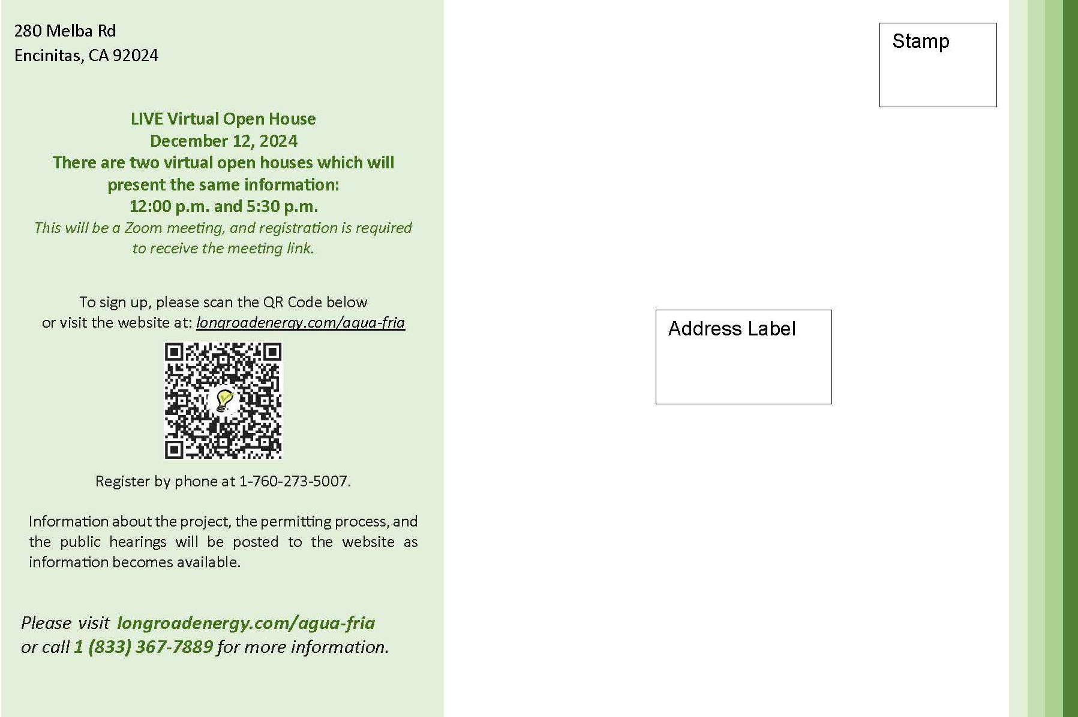
PUBLIC PROCESS MAILER #1

Slide 59
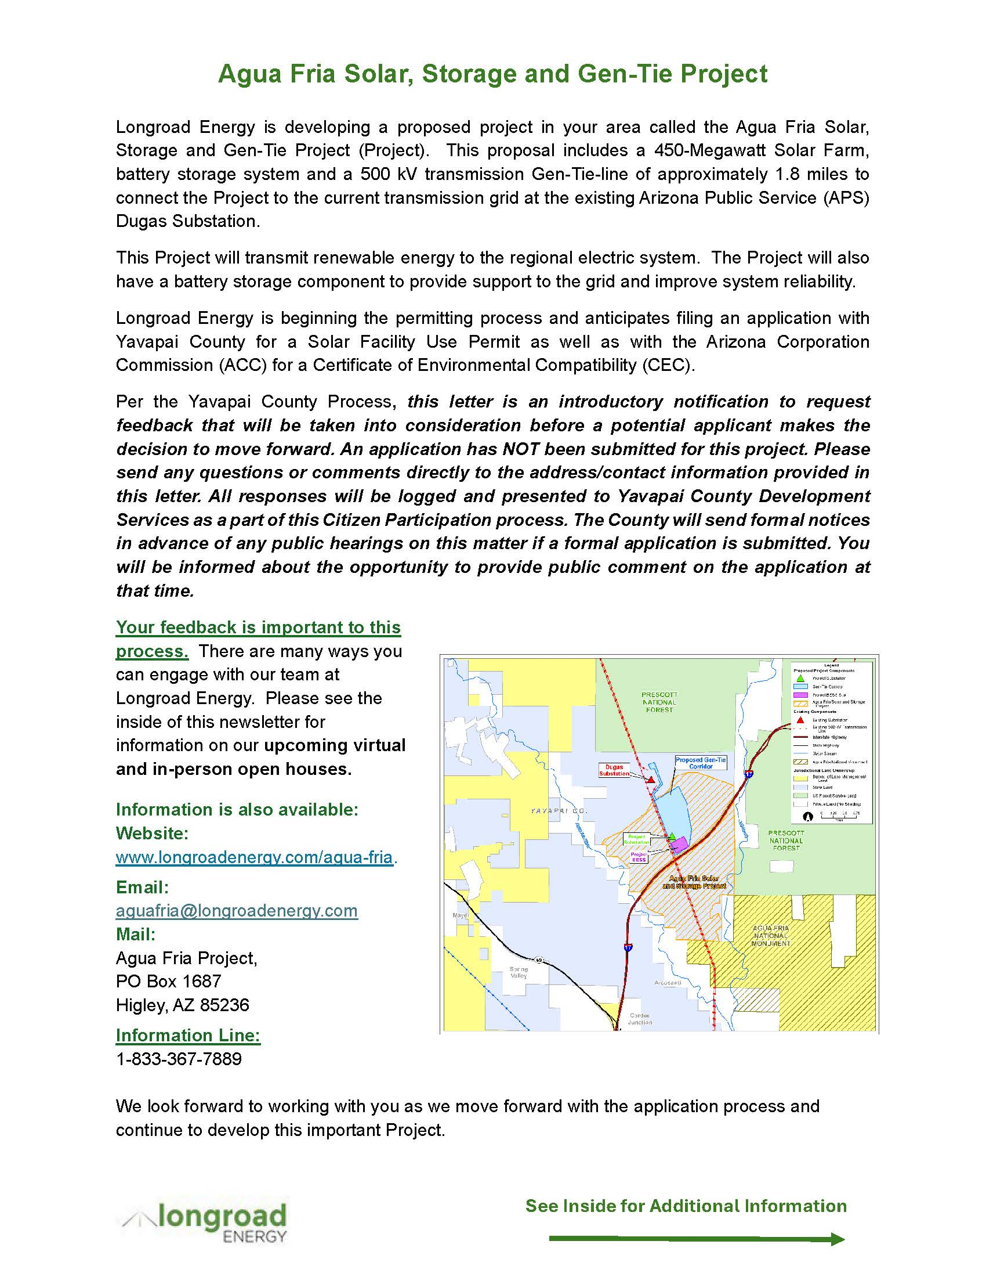
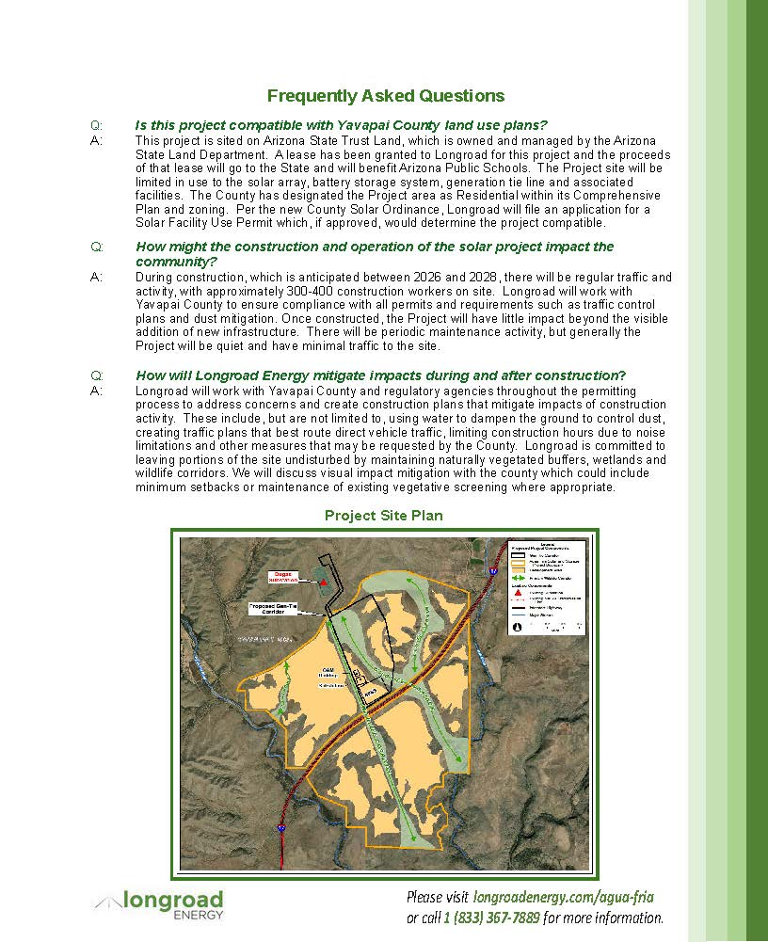
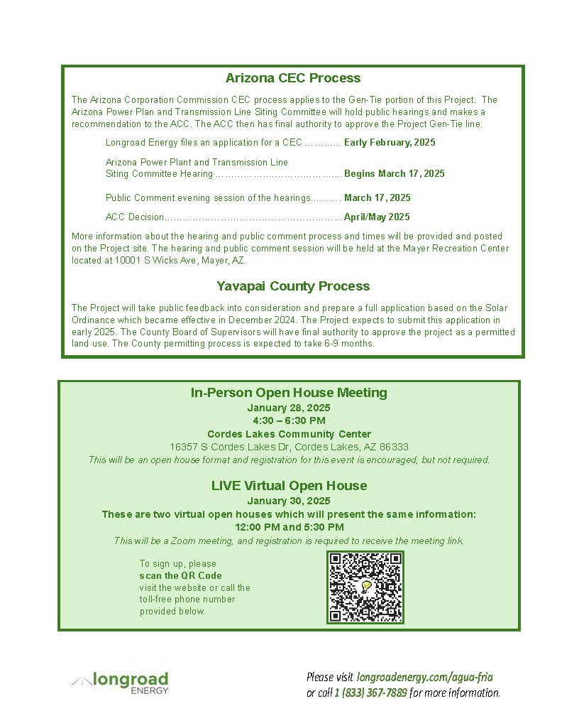
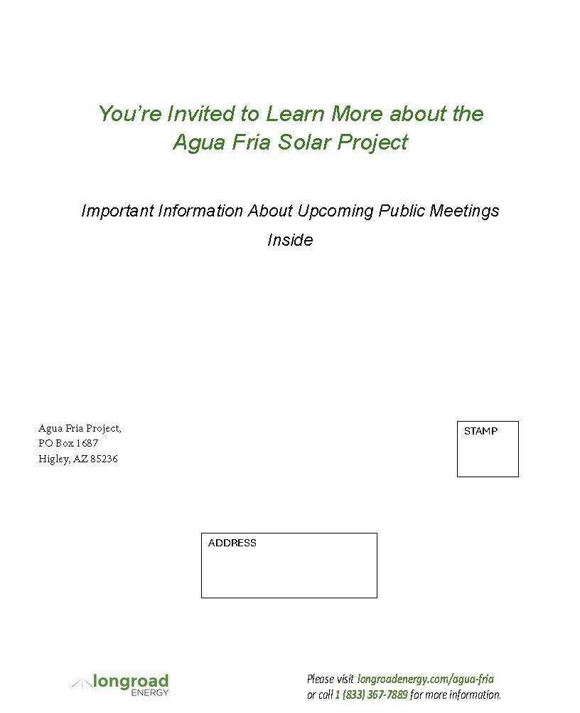
PUBLIC PROCESS MAILER #2

Slide 60
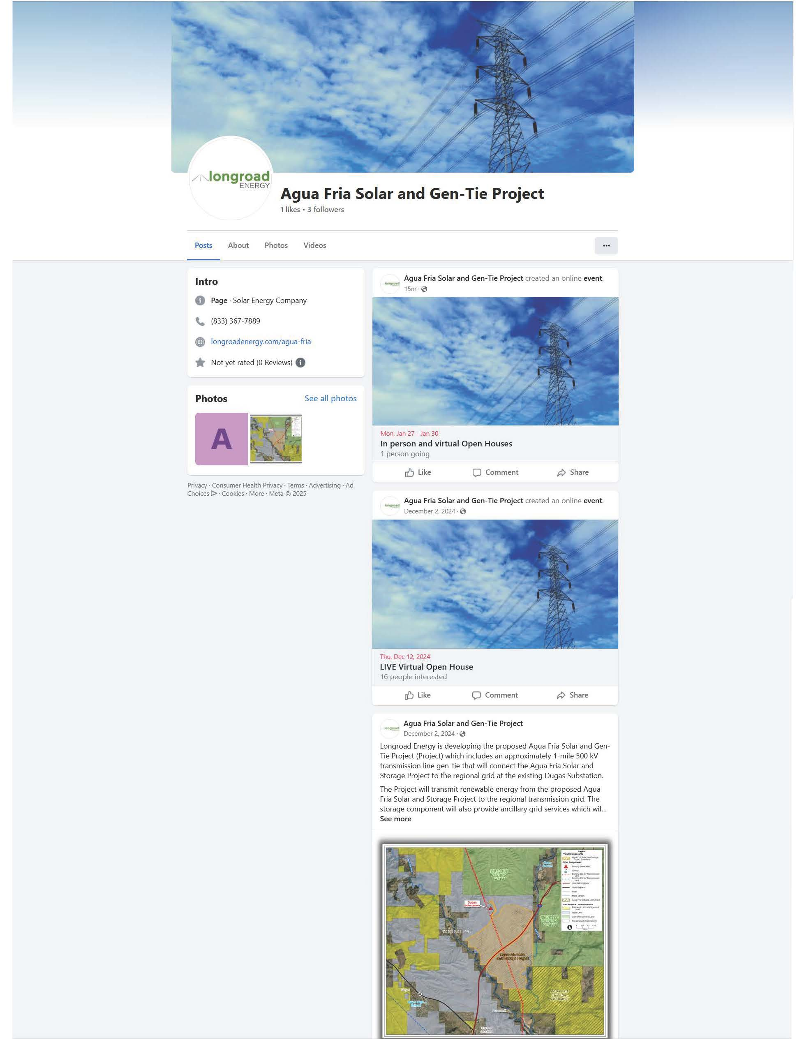
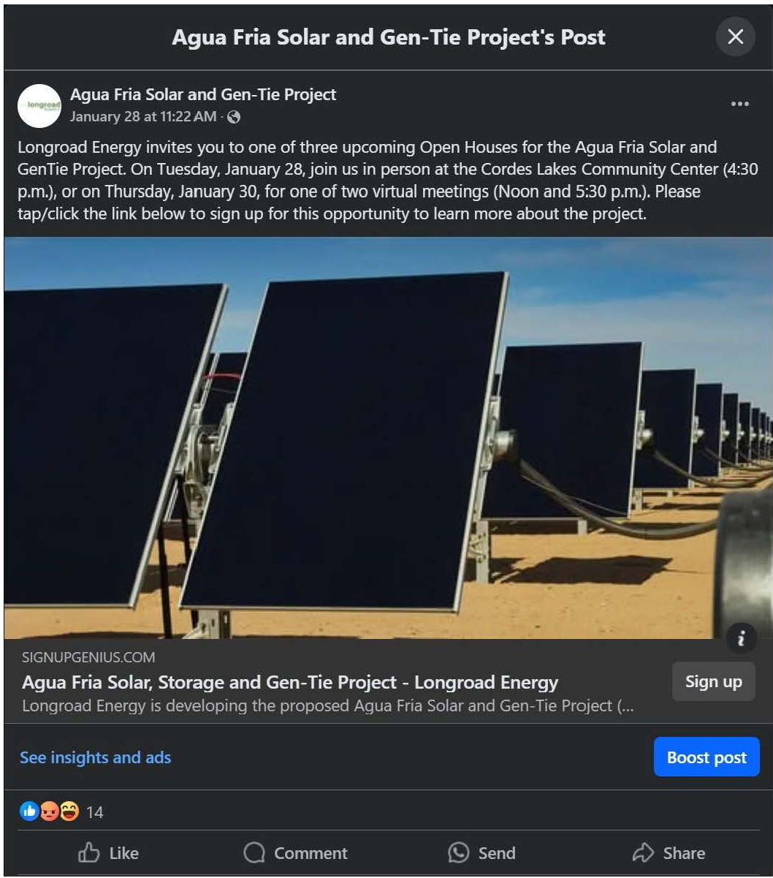
SOCIAL MEDIA

Slide 61
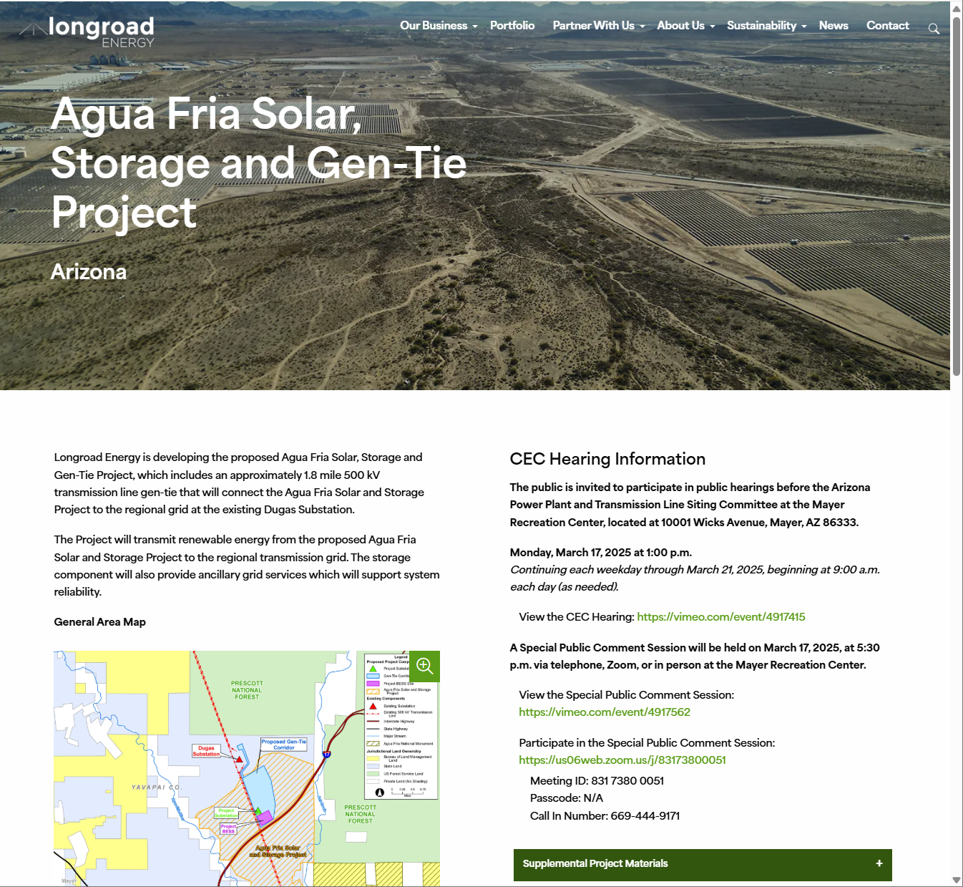
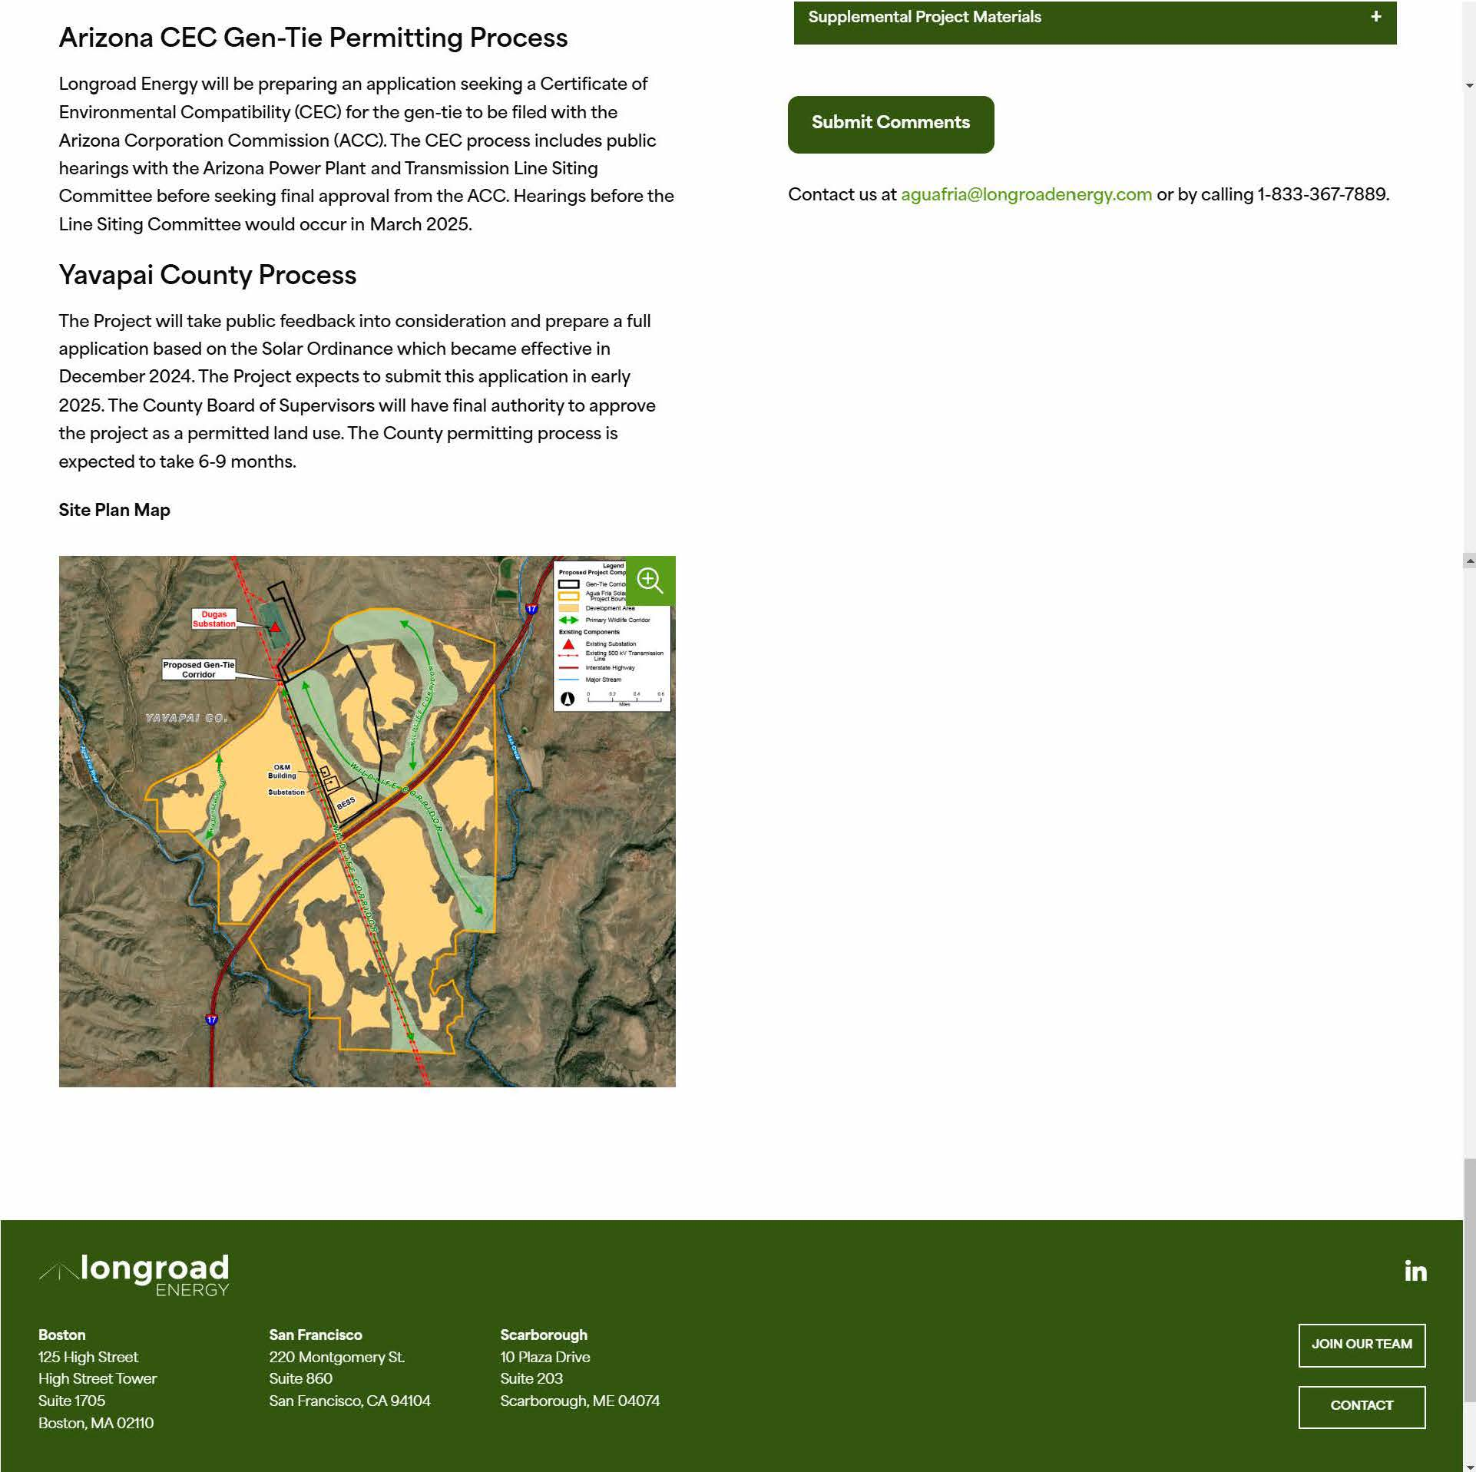
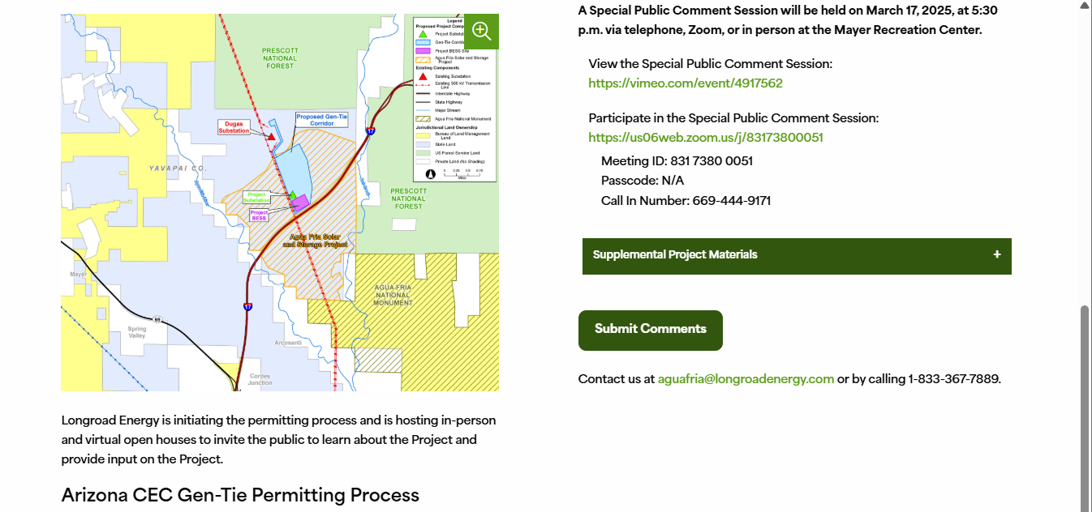
PROJECT WEBSITE

Slide 62
STAKEHOLDER MEETINGS
Representative Key Stakeholders:
Yavapai County
Mayer Fire District
Mayer School District
Arizona Game and Fish Department
Orme Ranch
Additional stakeholder meetings are included in Exhibit J.

Slide 63
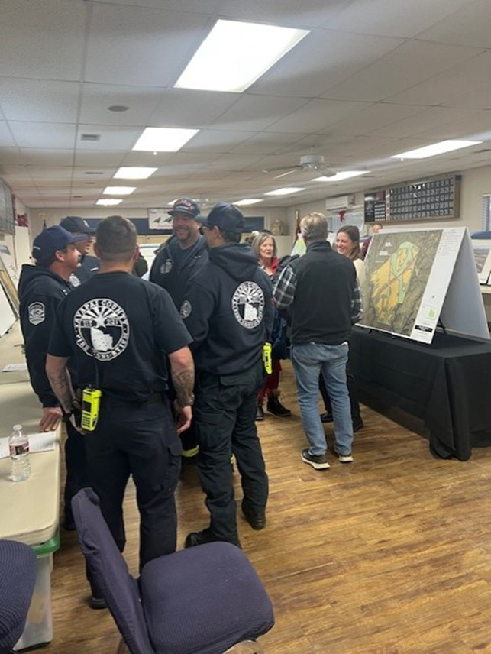
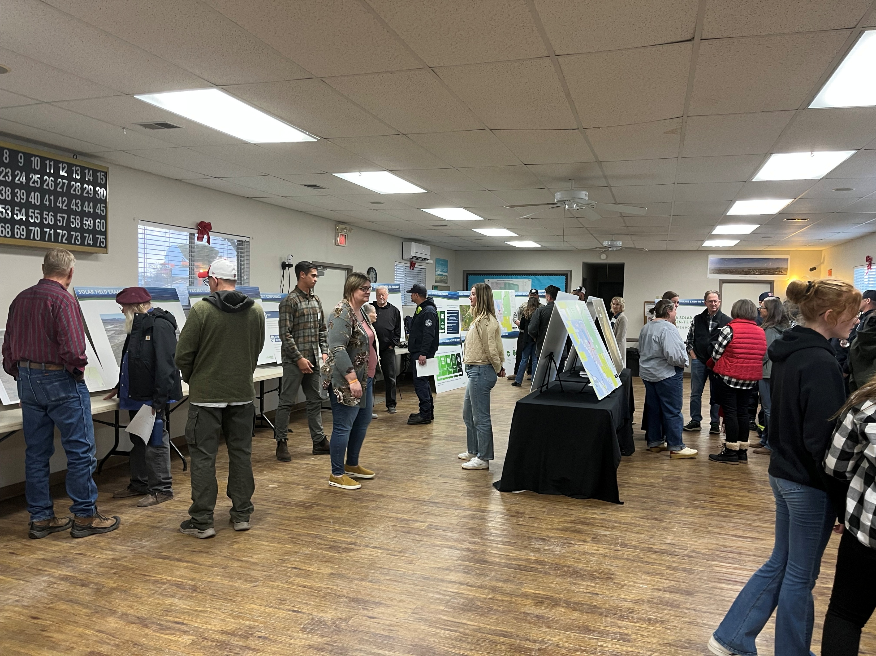
OPEN HOUSES

Slide 64
Conclusions of Panel

Slide 65
Thank you!

